Slide 1
Response Volunteer
Voluntary Services Team
22nd April 2020
Training for all West Herts Hospitals Trust volunteers in response to the COVID-19 Pandemic
Mark Cruise – Voluntary Services – March 2020

Slide 2
Response Volunteer Training
Introduction | 09:15 – 09:25
Covid-19 & Infection Control | 09:25 – 09:45
How ‘Response Volunteer’ will work | 09:45 – 10:00
Break | 10:00 – 10:15
Tasks within the Response Volunteer role | 10:15 – 10:35
Rules and Guidelines | 10:35 – 11:10
Self Care | 11:10 – 11:40
Recap and Questions | 11:40 – 12:00
Mark Cruise – Voluntary Services – March 2020
Notes:
Explain where fire exits and toilets are. Explain what this training is about and how it will run.

Slide 3
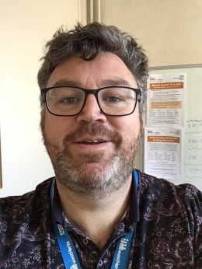
Voluntary Services Team
Sophie Baker – Secretary/Administrator
Shilva Biju – Administrator
Charlotte Mansell - Administrator
Phone: 01923 217 307
Email: westherts.volunteers@nhs.net
Mark Cruise – Youth Volunteer Manager
Phone: 074 071 214 28
Email: mark.cruise@nhs.net
Aga Dychton – Emergency Department and Patient Lounge Volunteer Coordinator
Phone: 075 709 491 62
Email: aga.dychton@nhs.net
Ruth Paterson – Voluntary Services Lead
Phone: 078 816 238 36
Email: ruth.paterson@nhs.net
Mark Cruise – Voluntary Services – March 2020
Notes:
Introduce self and team.

Slide 4
Infection Control
Mark Cruise – Voluntary Services – March 2020

Slide 5
Symptoms of COVID-19
COVID-19 is a new illness that can affect your lungs and airways. It's caused by a virus called coronavirus
https://www.youtube.com/watch?v=isTGA_UHH-E
It can take up to 14 days for symptoms of coronavirus to appear.
Look out for one, some or all of the main symptoms:
A cough – this can be any kind of cough, not just dry
shortness of breath
breathing difficulties
Fever (high temp – 38 degrees Celsius or above) or chills
Other symptoms are fatigue, headaches, sore throat, aches and pains.
You may be at high risk from coronavirus if you:
have had an organ transplant
are having certain types of cancer treatment
have blood or bone marrow cancer, such as leukemia
have a severe lung condition, such as cystic fibrosis or severe asthma
have a condition that makes you much more likely to get infections
are taking medicine that weakens your immune system
are pregnant and have a serious heart condition
YOU SHOULD NOT BE VOLUNTEERING IF YOU ARE OVER 70 OR IN A VULNERABLE CATEGORY
Source: https://www.nhs.uk/conditions/coronavirus-covid-19/
Notes:
Emphasise the risk and you shouldn’t be here.

Slide 6
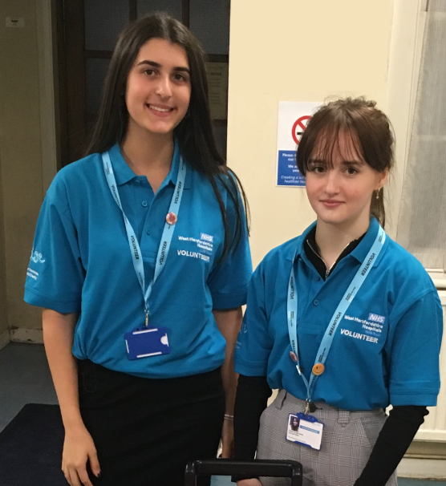
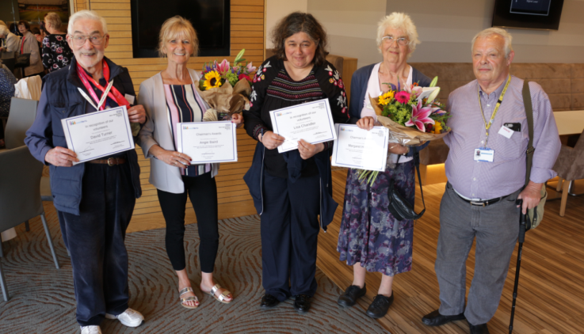
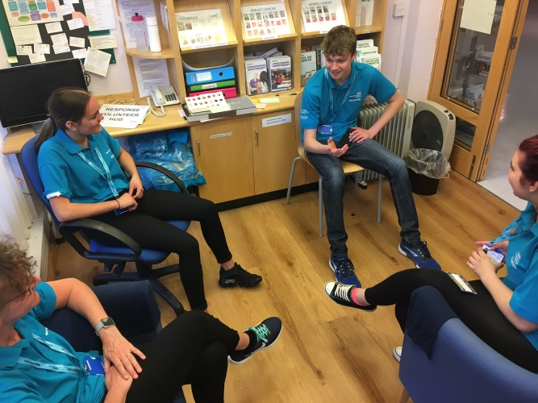
Response Volunteer – how it works
Background:
This role has been developed in response to the unique challenge that the COVID-19 Pandemic.
Prior to this outbreak, we had 40 roles across 3 sites, with over 800 volunteers. Each role had a specific purpose: Outpatients, Reception, Mobility, Dining Companion, Youth Peer Support etc.
We have had to ask volunteers who are over 70 and otherwise vulnerable to step back
In response to the outbreak, we are rolling out the Response Volunteer role, as one flexible role.
.
Mark Cruise – Voluntary Services – March 2020

Slide 7
Response Volunteer – how it works
The Role:
Response Volunteers will have a wide range of potential duties:
Bringing items up to wards,
Delivering water & food to staff on isolated wards
Processing and distributing donations
assisting on wards during mealtimes,
collecting medication,
office admin and
a number of other tasks.
What you will do on each shift will vary – depending on what is needed
It is the job of the Voluntary Services team to match the needs of the hospital staff up with the availability of Volunteers.
We will agree a shift time and day for you to come in
When you arrive, you should come to the Volunteer Hub (the Macmillan Drop-in at Reception) to sign in, meet Voluntary Services and start your shift
Your shift may involve just one task for 3 hours (helping with Patient Services for example) or many shorter/quicker tasks.
You should not be asked to put yourself at any risk or danger. If you feel unsafe or worried – please come and speak to Ruth, Mark or Aga
Mark Cruise – Voluntary Services – March 2020

Slide 8
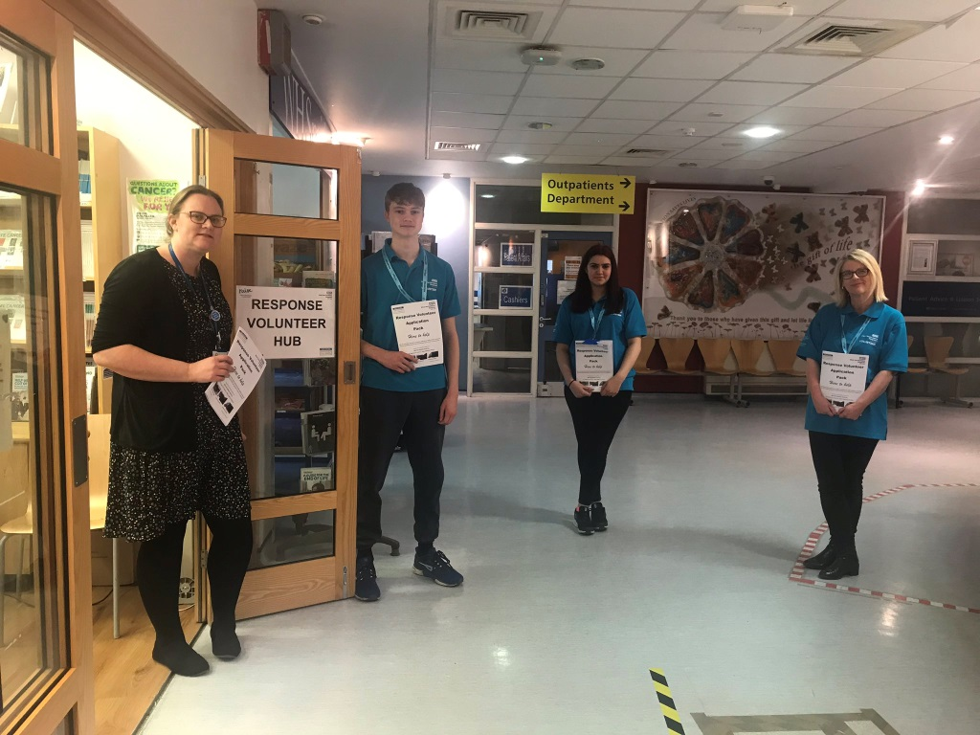
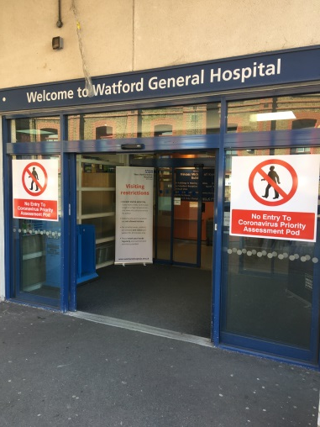
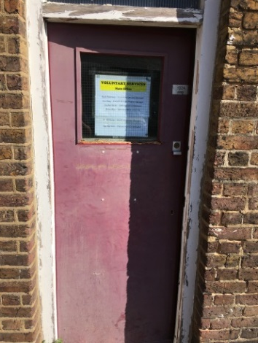
How it works - Orientation
This role is based at Watford General Hospital (WGH)
Shifts are (currently) Mon-Fri, 8:30 to 5:30 and will be 3 hours long. For wellbeing and self-care, you should not do longer shifts
When you arrive – come to the main building and come to the Volunteer Hub opposite Reception. The official title of the main building is: Princess Michael of Kent, but is known as ‘P-MOK’
PMOK Main Entrance
The Voluntary Services Office will remain open in the Admin Block
The Volunteer Hub will be based at the Macmillan Drop-in opposite reception
Mark Cruise – Voluntary Services – March 2020
Notes:
Shifts may well change in the coming weeks – ask people how well they know the hospital.

Slide 9
ORIENTATION
There are over 20 separate buildings with over 90 different wards, departments and services at WGH.
There isn’t an expectation for you to know where every department is based, but you should familiarise yourself with the WGH map and learn:
Parking locations (disabled, staff and patients)
Reception
Canteen
A&E, AAU,
Covid-19 Assessment Pod
Maternity
Ambulatory Care
Patient Affairs & Patient Advice & Liaison
Where all the Isolation Wards are
The team at Reception, plus the Volunteer Support Team can help you with orientation.
Mark Cruise – Voluntary Services – March 2020
Notes:
Ask people if they know where our office was, and is now?

Slide 10
Orientation – Vol Services Office
Mark Cruise – Voluntary Services – March 2020
Notes:
Move on to Role Discussion

Slide 11
Give us your digits….
We have set up a WhatsApp group called ‘Response Volunteers’ that we would like all volunteers to join.
This is generally the easiest way to communicate and share information.
This will be managed by Mark, Ruth and Aga.
We will be asking you to complete an online survey after each shift, to measure and record our work. We will share details of this survey on the WhatsApp Group
Mark Cruise – Voluntary Services – March 2020

Slide 12
Week 1-3. How did it go?
We have 27 active volunteers
Volunteers donate an average of 7 hours time per week
We receive an average of 36 requests per day
The most common tasks were:
Bringing patient belongings to wards
Bringing drinks and snacks for staff
Admin assistance
Helping with donations and distribution
Mark Cruise – Voluntary Services – March 2020

Slide 13
Mark Cruise – Voluntary Services – March 2020

Slide 17
Break!
See you in 15
Mark Cruise – Voluntary Services – March 2020
Notes:
Up next – talking about specific roles in a bit more details. Ask people what roles they have done here or other hospitals?

Slide 18
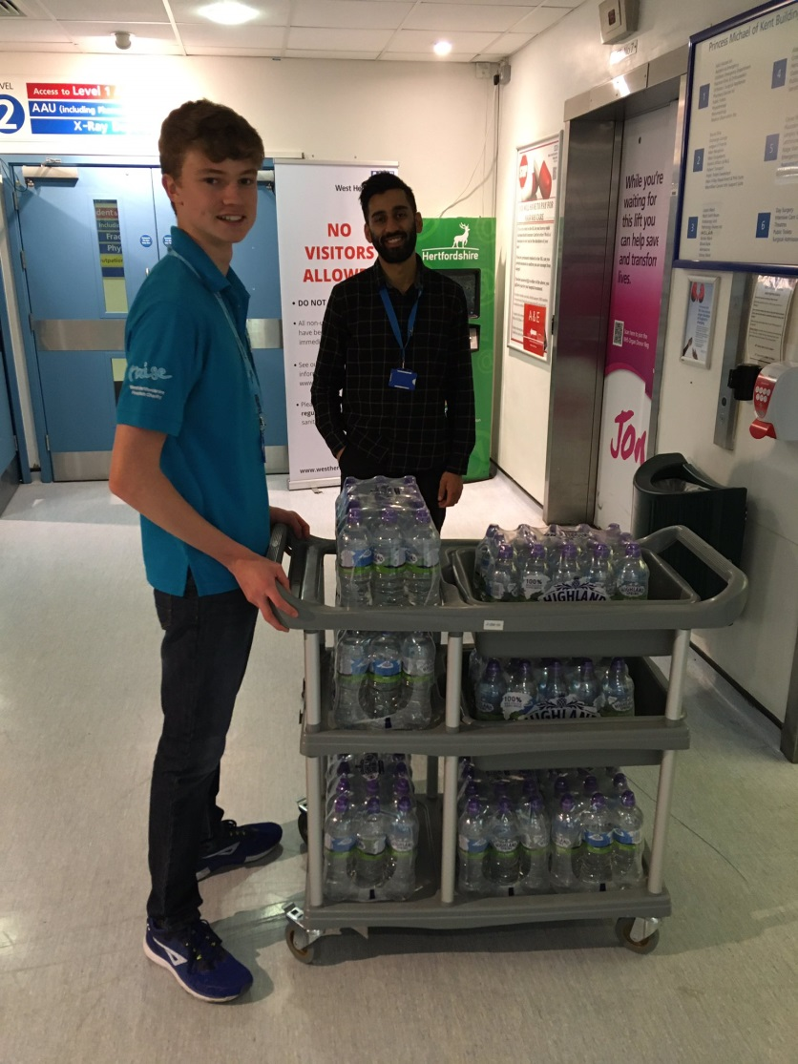
Water & Food Re-Stock
Tasks
Staff on Covid-19 positive wards are unable to take water breaks, and can often find it difficult to get a proper lunch break
WHHT has set up a system to keep the Covid-19 positive wards stocked up with food and drink
Response Volunteers are a vital part of this – restocking these areas between 2& 4 times a day.
Since the role began on March 31st, we have delivered over 4000 bottles of water.
We also deliver snacks, sandwiches and hot food.
We help manage stock rotation – ensuring food hygiene is maintained and stock control is practised
We also distribute snacks and treats to staff in non-Covid positive wards.
Mark Cruise – Voluntary Services – March 2020

Slide 19
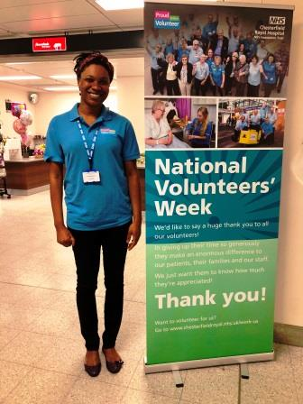
Patient Running & Wayfinder
Bringing items from the hub to the wards
Ensure correct forms have been filled in.
Valuables? Medication?
Observe infection reduction
Isolation Ward – bring item to door and get Nurse information
Non-isolation ward – bring item in and ask NIC if you can bring to patient.
Return form to Volunteer Hub
Also:
Direct patients to the correct location
Escort patients (and staff) to specific teams/services within the building
Support the reception team with patient transport, and assist with onward transport, bus timetables, taxis etc.
Gather extra support resources for patients and staff (other organisations, phone numbers etc)
Mark Cruise – Voluntary Services – March 2020
Notes:
Mention vols putting together folders with information

Slide 20
Other Tasks
TTA/TTO
Patient Affairs / PALS
Surgery PPE Supervision
Maternity Reception
ICT Support
PPE Assembly
Patient Belongings Returned
Mark Cruise – Voluntary Services – March 2020
Notes:
Ask Ruth/Aga to mention other Roles. Invite questions.
Move on to communications. Emphasise these are worst-case scenarios

Slide 21
Communication with Staff, Patients and the Public
Remember, all patients and visitors will be apprehensive or scared
They may have had difficulties on NHS111 or with their GP, parking etc.
Be clear – if you don’t know, say you don’t know, and offer to find out or get help.
Do your best, but don’t make promises.
Try to remain calm and polite – you should not face abuse, and you should report any aggressive behaviour.
Staff will be busy, overwhelmed and tired. They may not realise that you don’t understand what they are saying. Ask for clarification, remind people what you are and aren’t able to do.
If staff or the public are abusive – let us know immediately.
What you see and hear
Home
Work
Family
Today
Money
Mark Cruise – Voluntary Services – March 2020
Notes:
Offer a role play of a stressed/angry visitor who can’t see their elderly parent and doesn’t know what's going on.

Slide 22
Mandatory Rules
If you feel unwell in any way – do not come in
If members of your household are self-isolating – do not come in.
Wash or Sanitise Your Hands
Bare below the elbows, No:
Jewellery,
Watches,
Rings,
Bracelets,
Bangles etc
You must wear your Volunteer Polo Shirt (two, if you are doing two shifts – wash after each shift).
Hair tied back
Do not go onto Isolation Wards (look for staff w masks)
Hand wash after every direct interaction with patient/public/task
Observe patient confidentiality
Do not agree to buy anything for patients – do not handle money or accept money.
Mark Cruise – Voluntary Services – March 2020
Notes:
* Check glove policy

Slide 23
Boundaries & Confidentiality
Everyone within in the NHS has a legal obligation to keep all patient and related information confidential. This also applies to Volunteers.
It is essential that people can be confident that their personal information is kept safe and secure and that people maintain the privacy of the individual, whilst sharing information to deliver better services.
We need to be mindful of other people’s spiritual and cultural beliefs, and we also need to remember to keep our own personal feelings to ourselves.
The ONLY time this confidentiality should be breached is when disclosing a Safeguarding concern. If you have a Safeguarding Concern, you must speak to Mark, Ruth or Aga before finishing your shift
BOUNDARIES
Volunteers are part of the Trust, and as such are expected to have firm boundaries with patients and visitors
Don’t offer to buy anything for patients or visitors. Don’t accept money
Volunteers should not be asked to carry out the full job of a paid staff member
Volunteers should not have access to medical records or should not discuss patient information with anyone.
Volunteers should not go onto wards that are Isolated. Isolation areas can change rapidly – but any ward where staff are wearing masks, is an Isolation ward.
Notes:
Explain full job v individual task

Slide 24
SELF CARE
Importance of sticking to boundaries
Taking time for yourself
Identify your support network in advance
Where to seek support
Us
Pastoral Care
Wellbeing Team
Employee Assistance Programme & Online Counselling
03303 800 658 / vivup.co.uk - Register.
Mark Cruise – Voluntary Services – March 2020

Slide 25
Do & Don’t
Do:
Clean hands every patient
Keep offering feedback to help us develop the role
Wash your Polo shirt after each shift
Spread the word – tell people you what you are doing
Stay in touch – let us know if your circumstances change
Let us know if you cannot make your shift
Don’t:
Pay for parking – No parking
Keep your worries to yourself
Come in if you feel scared or at risk
Be afraid to tell us you don’t know what to do
Mark Cruise – Voluntary Services – March 2020
Notes:
* Aga to confirm

Slide 26
Any Questions?
What days and times can I volunteer?
Right now, we can only manage volunteers between 8:30am and 5:30pm Monday to Friday. We hope to expand this as we move forward
Can I carry on in my existing role?
We are stopping all other existing volunteer roles at Watford Hospital
What if I want to stop volunteering?
If, for any reason, you do not want to keep coming in to volunteer – that is absolutely fine. Obviously if there is a problem or an issue, we would like the opportunity to fix it. But if you are stopping, please do let us know.
Is there someone I can talk to if things get too much?
Come and speak to Aga, Ruth or Mark. If we can’t help, we can signpost you to someone who can.
What if I want to volunteer at Hemel Hempstead or St Albans?
We hope to roll this service out at both HHH and SACH soon. We want to ensure it is working properly at WGH first.
If there is a particular task that I don’t enjoy or find difficult, can I ask not to do it?
Whilst we will try our best to facilitate you, it may not be possible.
If I have any concerns, who do I speak to?
You can come and speak to Ruth, Mark or Aga at the Volunteer Hub. You can also email or call us. If you would rather escalate it, you can contact: Colette Datt – Lead Nurse, Patient Experience & Public Participation.
Mark Cruise – Voluntary Services – March 2020

Slide 27
Before You Leave…..
What’s happening with your ID?
Do you have your Polo Shirt/s?
Do you know where the Volunteer Hub is?
Have you given us your mobile # for WhatsApp?
Make a note of the EAP
Sign the Declaration & Parental Guidance
Get a meal voucher
Tell us your Rota availability
Mark Cruise – Voluntary Services – March 2020

Slide 28
Obligatory Motivational Ending
C | Clear communication
O | Observe boundaries
V | Vital to look after your wellbeing
I | Inspire those around you
D | Do your best!
Mark Cruise – Voluntary Services – March 2020

