Slide 1

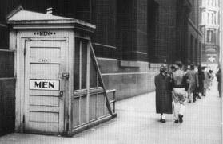

Rotary and Health & Wellbeing
Rotary - The beginning
Doing Good in the World
Notes:
Good afternoon – amongst other volunteer roles I am a Rotarian.
Rotary is over 100 years old
We were set up as a networking organisation by several guys (they were all men then) who were new in Chicago and wanted to get to know more people
They soon found that they could undertake philanthropic work and set about building the first public toilets in the city.
They had already provide a local doctors with a horse to get around his patients as his old one had passed away.
We have been involved in Health & Wellbeing from the start ….

Slide 2







Rotary and Health & Wellbeing
We tend to direct our efforts in six areas to enhance our local and global impact.
Promoting peace
Fighting disease
Providing clean water
Saving mothers and children
Supporting education
Growing local economies
Doing Good in the World
Notes:
Rotarians all over the world now try and focus our activity on six areas, including Health & Well-being in all its different guises

Slide 3
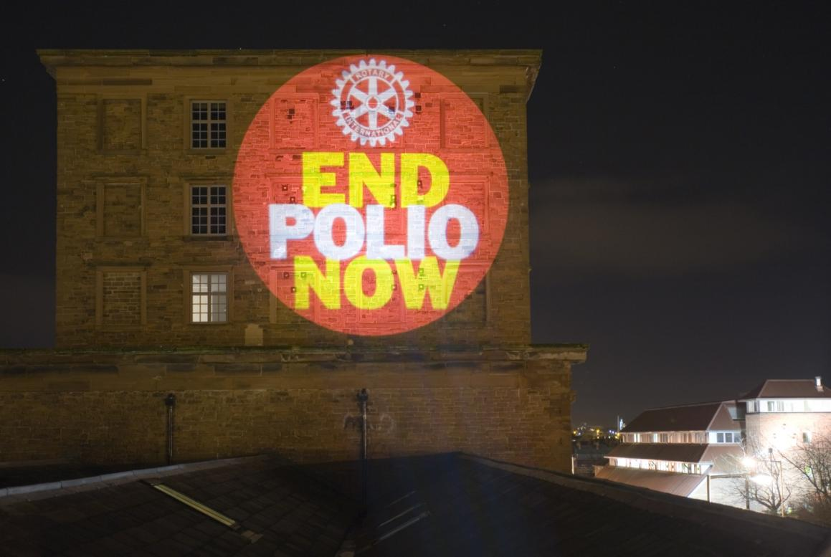
Rotary and Health & Wellbeing
Doing Good in the World
Notes:
A key activity over the past 30 years has been helping to eradicate Polio. From 350,000 cases per year we are now down to around 30 in 2018.
These last cases are proving the most difficult, as they are in Pakistan & Afghanistan. We also have some issues in other difficult areas such as Syria.
Vaccination is a hot topic of course, even in our developed western countries.

Slide 4
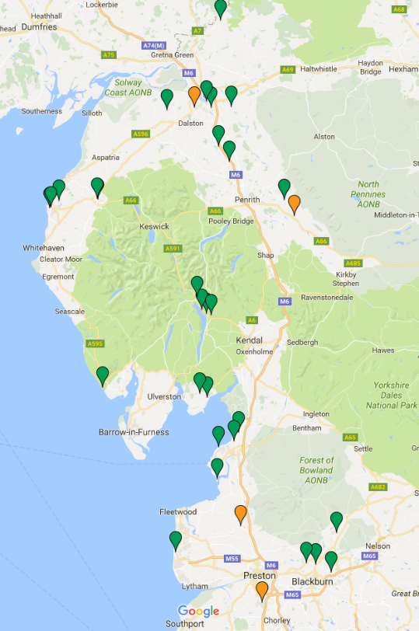
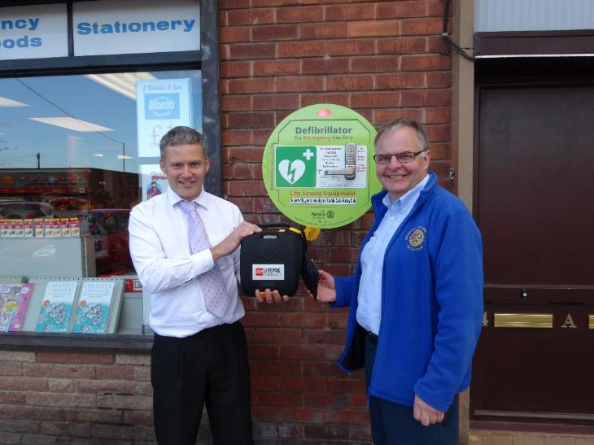
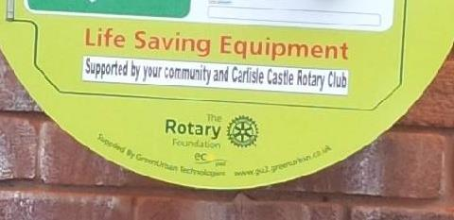
Rotary and Health &Wellbeing
Doing Good in the World
Notes:
In 2013/14 I had the privileged of supporting all the clubs in Cumbria & Lancashire as their District Governor.
During the year we prepared to implement a First Response relate health project which resulted in equipment for Mountain Rescue Teams; Around 40 Public Access Defibrillators and more pertinent to todays discussion a series of Community Health events

Slide 5
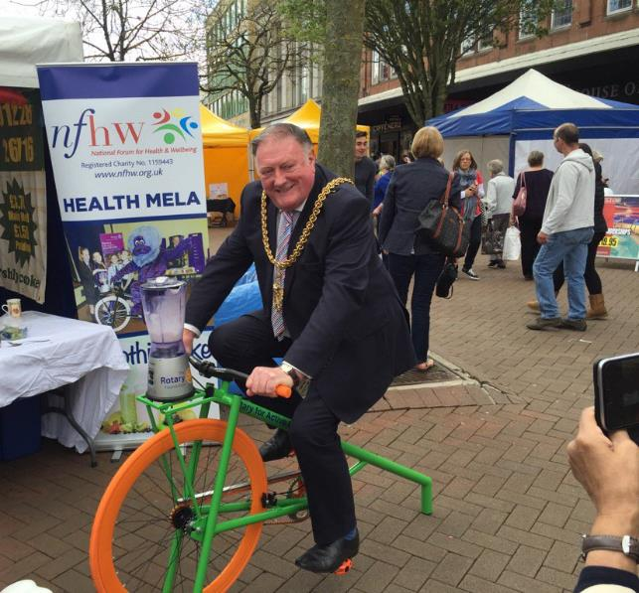
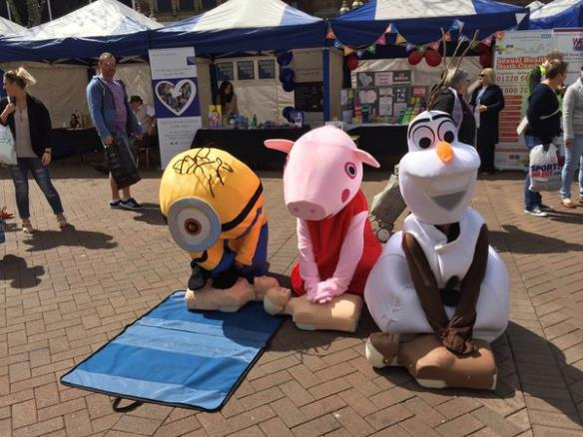
Rotary and Health & Wellbeing
Health Mela’s
Great examples of Rotary at the heart of our communities
Notes:
The Health Melas included in the project were in the city centre of carlisle in 2016 & 2017. One in a secondary school in Carnforth, Lancs and two more recent events in Auction Marts in Wigton & Cockermouth in North Cumbria. There have also been events in Barrow, Ulverston & Millom in South Cumbria.
I had come across the National Forum for Health & Wellbeing who had been holding Health Melas Preston in since 2002. It became an annual event soon extending its influence way beyond its initial focus on the Gujarat community.
Mela is a Sanskrit word for allowing communities to learn in a friendly and enjoyable environment.
Their 12th Health Mela, held in the Guild Hall in 2013, attracted over 2,000 visitors of all ages and ethnicities.

Slide 6
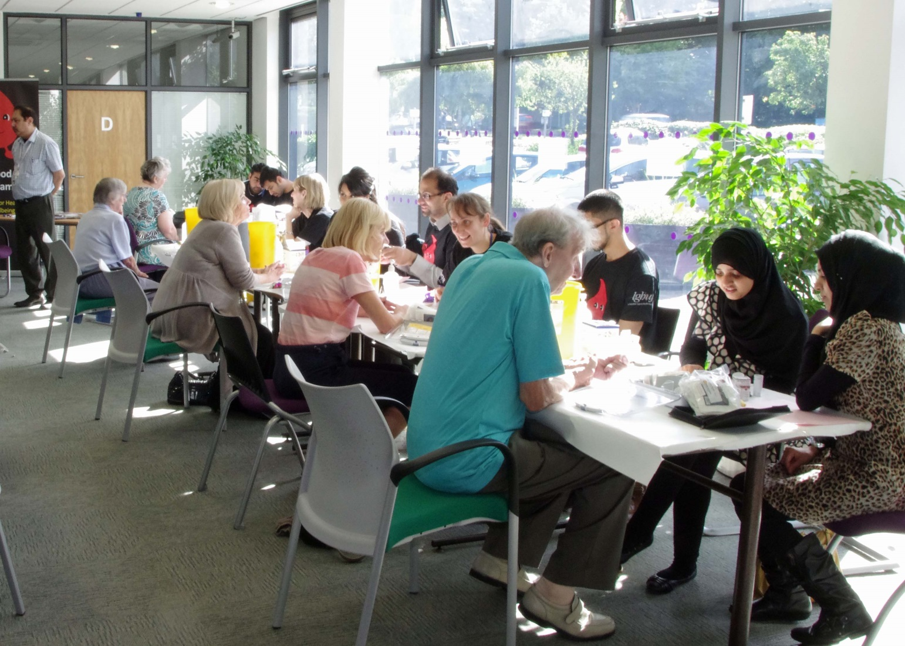
a comprehensive selection of health checks (the Health MOT) together with appropriate advice and counselling.
Notes:
Central to the day’s activities is
a comprehensive selection of health checks (the “Health MOT”) together with appropriate advice and counselling.
It can offer visitors checks on:
body mass index
blood pressure
cholesterol level
blood glucose
sight
hearing.
On this scale a team of trainees and other clinicians volunteer to take the tests and provide advice and guidance.
Nfhw also aims to provide local health professionals in training with the opportunity to experience work in a community led setting. This activity is endorsed by the General Medical Council.
Health Melas also provide a much appreciated networking opportunity for local health professionals.

Slide 7
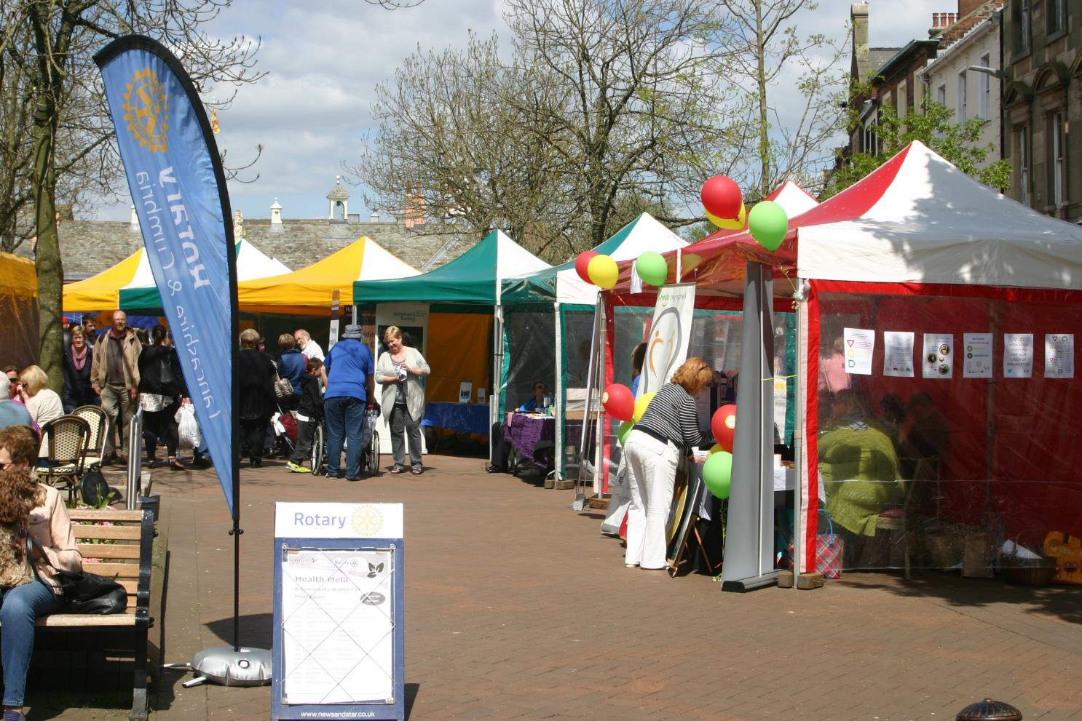
Taking over Carlisle City Centre
on a Saturday in May
Notes:
So, I was keen to bring this concept out of Lancashire and found a venue and willing community in Carlisle
Taking over the City Centre on a Saturday
With a number of “Streets” hosting ……..
Health & Wellbeing advice
Complementary Therapies
Listening Therapies
Food & Cooking
Gardening
Exercise
Music & Entertainment
We had around 40 stalls and

Slide 8


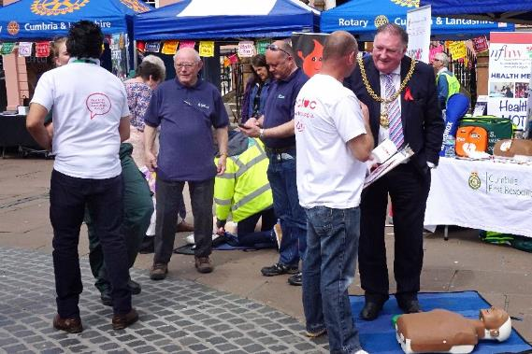
Partners over the 2 years included;
Sustainable Carlisle
Carlisle City Council – Healthy City Initiative
Carlisle Ambassadors
The Cumbria Partnership NHS Foundation Trust
Cumbria CC, Public Health Team
CFM / BBC Radio Cumbria
Carlisle College
Lloyds Pharmacy
Notes:
A wide range of partners within the local community got involved
Funding was from
Our Rotary Foundation, First Response Global Grant
In Kind Donations from Carlisle City Council
Cumbria Community Foundation
Cumbria CC, Public Health
But was this scale of event sustainable?

Slide 9
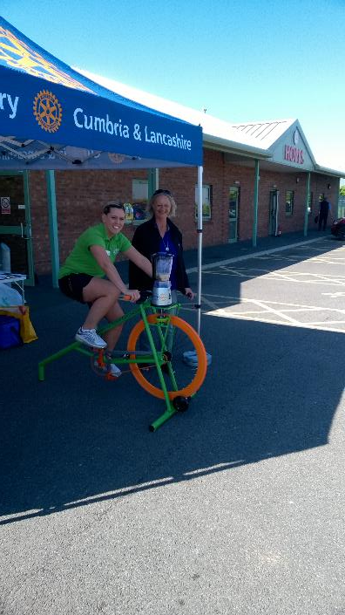
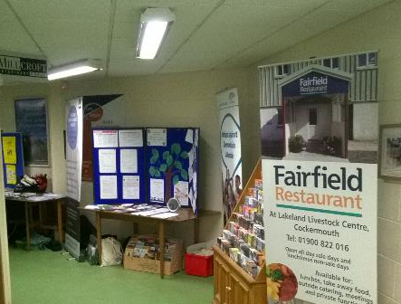
Rotary and Health & Wellbeing
Focussed Events Summer 2018
Wigton Auction Mart
Cockermouth Auction Mart
Notes:
We needed to try something on a smaller scale, and many of the local interventions that Rotarians are involved around the country working alongside the Stroke Association are just that
So we identified the possibility of working with the Auction Marts in Wigton & Cockermouth.
Local GP Practices provided the assessment teams and we had around 8 – 10 stalls providing advice and support.
Hard to reach groups (in the farming community) were successfully targeted.

Slide 10
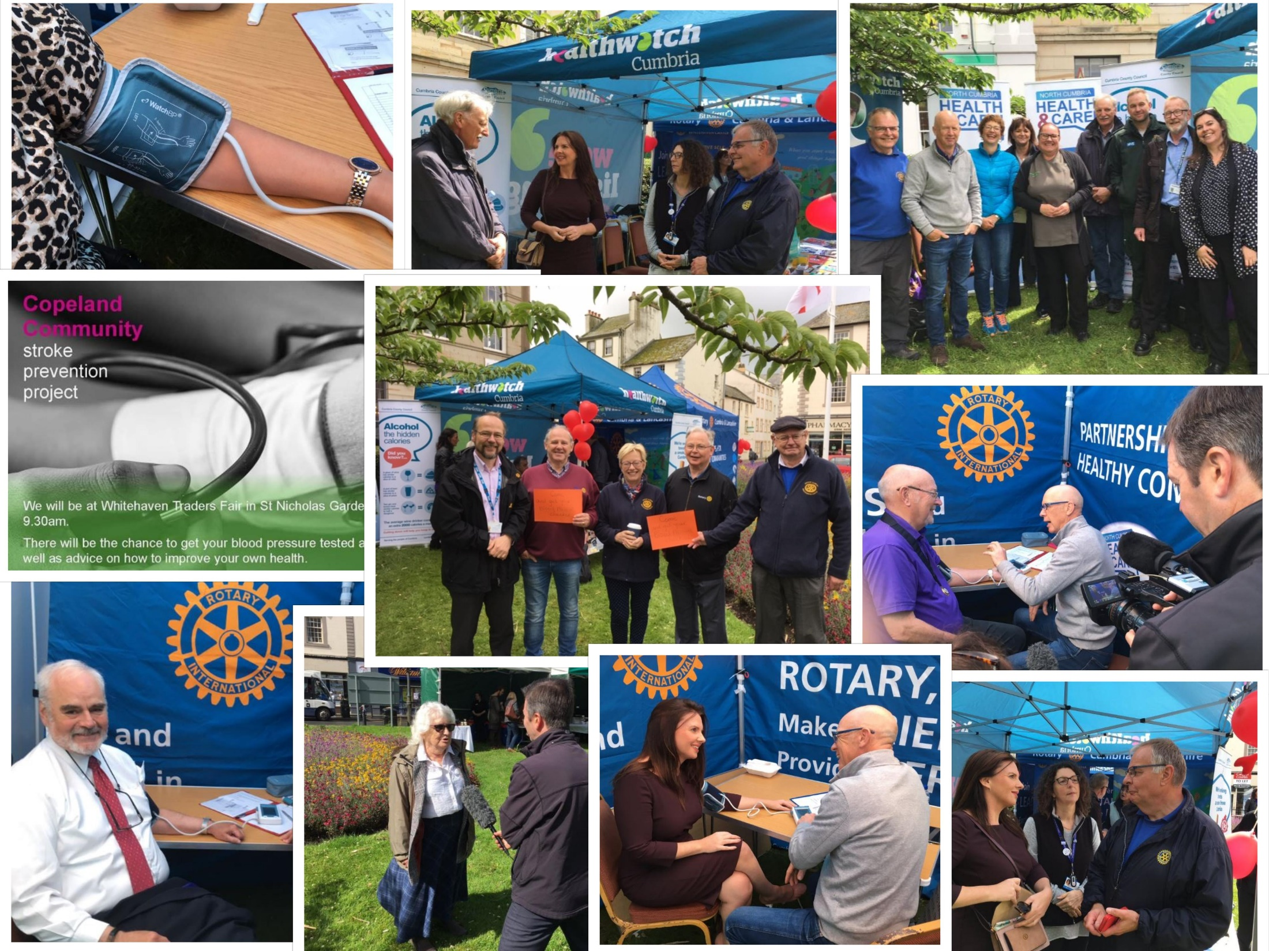
From Public Health data
Main risk factors:
  Smoking: 9000 people in Copeland over the age of 15 are recorded by their GP as being a smoker. People with manual occupations have a 33% chance of smoking.
  Lack of physical activity: 1 in 4 adults in Copeland are not getting enough physical activity (compared to other districts in Cumbria).
  Being overweight or obese: 65% of adults in Copeland are overweight or obese
  Excessive alcohol consumption: Hospital admissions for alcohol consumption rate is 25% higher in Copeland than the national average.
Notes:
Julie (Clayton) from our local CCG heard about the Community Health events I had arranged in Carlisle City Centre, and Auction Marts in North Cumbria and asked if I could help with developing community led events in Copeland. as part of the So what have the team in west cumbria been up to as part of the Building Health Partnership project?.
Mobilising Rotarians in Whitehaven and Workington Rotary we have arranged two, small scale, community Health events in the last few months.
Firstly at the Traders Day in Whitehaven on the 14th June and Sunday 7th July at the West Cumbria Vintage Rally in Distington.
We had a core multidisciplinary team involved in each event, but an organisation is needed to “host“ each day by booking the space and having appropriate insurance and risk management in place. Rotary was ideally placed to do this.
The events were held in two Gazebos allowing privacy for Blood Pressure and Atrial Fibulation tests to be undertaken.
Representatives from many of the organisations involved were on hand to provide advice and support and to encourage people to take advantage of the service.

Slide 11


Blood pressure and pulse testing at the St Nicholas Gardens in Whitehaven
The group also shared advice on the things people can do to improve their own health, and are key to reducing the chance of having a stroke.
The group saw:
  92 people who had blood pressure and/or pulse checks
  Ages ranged from 19-80 years
  11 people were referred to their community pharmacy with home monitoring to provide a more detailed picture
  2 were checked by a GP on the day
Notes:
In Whitehaven the local Pharmacy Teams led by the Community Pharmacy lead Lynn McFarlane, undertook over 90 assessments in our Gazebo. With 12% being referred for further checks.
The links with the pharmacies were a key factor in that they can continue to help with monitoring until it is clear that someone does need to visit the GP.

Slide 12
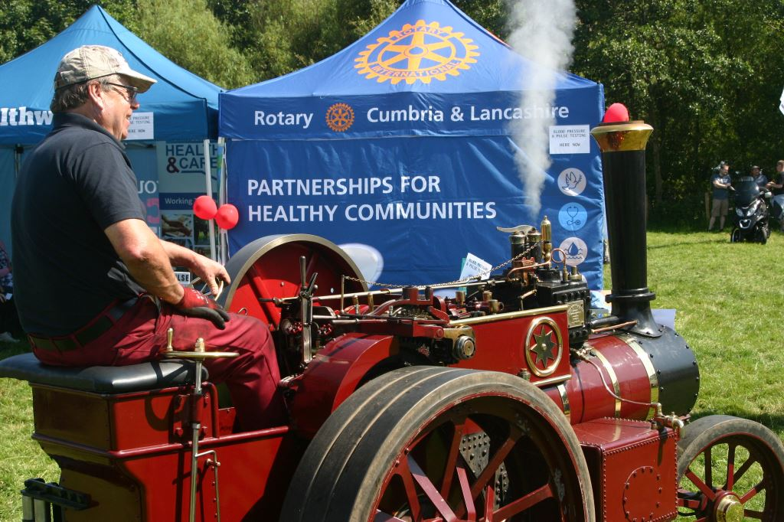
From Public Health data
Deaths from stroke:
  Kells ward has the highest mortality rate for strokes in Copeland – it is 104% higher than the national average.
  Moresby ward has the second highest mortality rate for strokes in Copeland – 95.8% higher than national average.
Emergency hospital admissions due to strokes:
Harbour ward has the highest rate in Copeland – 42% higher than the national average.
Notes:
The Distington Event changed the age and gender profile a little with an older and more male dominated profile. Not unexpected given the type of event.
This indicates that if we are to ensure that we arrange for as full a demographic coverage as possible a range of events and opportunities needed to be identified across the region.

Slide 13
Distington Vintage Rally
Notes:
You can see that more people were seen on the day than at Whitehaven and a higher % 22% were referred
Whilst its early days in assessing these pilot events it is clear that we have encouraged people to have their Blood Pressure and pulse checked. A good number have been referred for further investigation for issues they were initially unaware of.

Slide 14
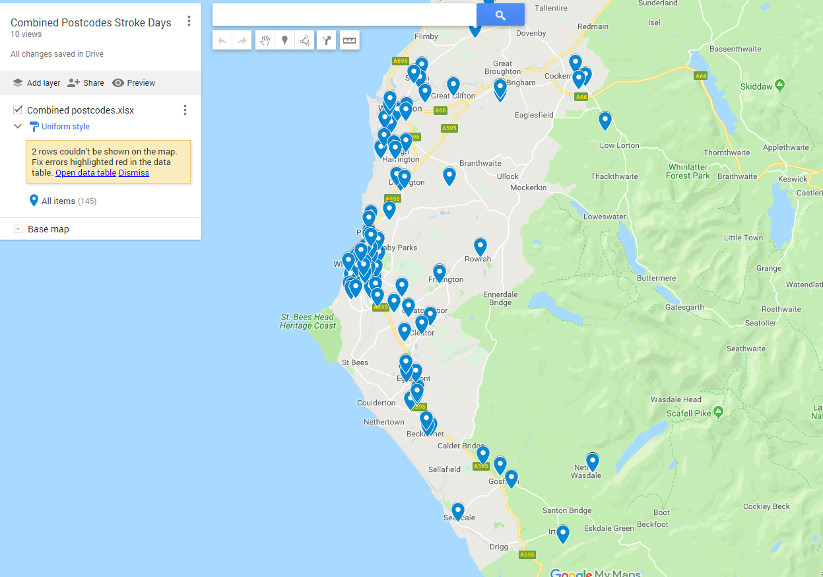
Notes:
By collecting the postcodes of those attending we can try to assess if these events are catching people from the wards we know are at highest risk.
This is a snapshot of those completing the feedback forms at both events.

Slide 15

“History of stroke symptoms/haven’t felt right”
“Just passing, handy, convenient”
“Don’t go to Doctor’s” or “wouldn’t have otherwise”
“Peace of mind”
Notes:
The overwhelming feedback from those attending has been very positive.
One lady I recall came along because she wanted her husband to be tested and went away with the knowledge that she herself needed some further checks.
Several came because family members had had strokes and they wanted some reassurance that they were OK
The volunteers played a key role in gently encouraging people to take a little time out of their day to take the tests.

Slide 16

Rotary and Health & Wellbeing
Final Reflections
Patience is a Virtue
Community based Capacity Building takes time
The NHS can be difficult nut to crack
Would I do it again ?
Yes – because we must always try and convert our visions into reality
Notes:
I’m keen to continue the development of these Community based health activities but am under no illusions as to the amount of work that is needed to bring them to reality.
To Third Sector and Community based colleagues - Don’t wait for your NHS teams to take a lead, their too busy, do it and they will follow.
Make connections – a key feature of all the events I have been involved in has been the level of networking that has taken place, particularly between the third sector and the statutory sector. Both groups need to know a lot more about what each other does.
Find your community activists and nurture them
Don’t forget about good governance, insurance, finances, safeguarding – there are plenty of models available for setting up structures that can be managed with a light touch.
Give it a go – and good luck

Slide 17
Building Health Partnerships
West Yorkshire & Harrogate Core Group
Dipika Kaushal
CEO
Voluntary Action Calderdale

Slide 18
Focus for BHP in Calderdale
Create social movement for change to improve population health at a local level linked to Musculoskeletal (muscle and joint) conditions
Change the relationship between the system and population focusing on being and remaining active

Slide 19
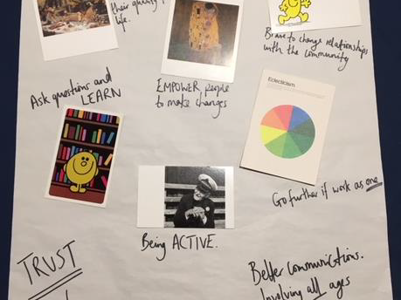
Insights from November 2019 consultation event

Slide 20
Doing and thinking differently
No assumptions
Be brave and bold
Different perspectives
Outcome = young people held the key
“I want to see Calderdale in ten years’
time as a safe and healthy place for my
younger and older relatives.”
“Physical activity includes getting up and
moving; this can be walking, running,
jumping or dancing - Activities that make
you feel good.”
“It worries me that if I don’t become more
active now I will be more worn down and
physically unhealthy when I’m older.”

Slide 21
A Socially Led Movement
Led by passionate people – Katie & Brian, College and Students, Calderdale CCG, Voluntary Action Calderdale
Young people pro-actively shaping and influencing thinking
Linking into existing movements – Active Calderdale, Calderdale Cares, etc

Slide 22
Walking the talk
Walk in the hills insight gathering exercise – June 19
Listen and learn from what young people have to say and can do to help shape future improvements
Intergenerational and community based/ led movement to create population health and wellbeing
Connecting people to what is available and accessible to them

Slide 23
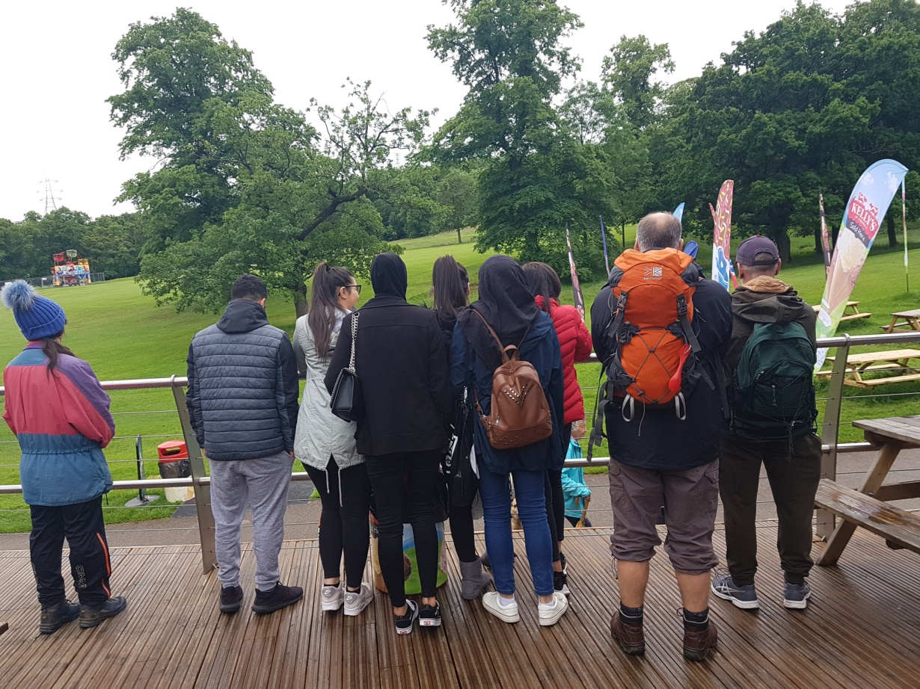
Connecting people with the place
‘The walk with Dipika and the team was very educational.
It was also very enjoyable as it allowed me to engage in discussion about exercise and the impact it has on health.
I gained a broader understanding and heard different view points from other people in the group and was engaged in discussing different ways to exercise. I
also felt like I learnt a bit more about Calderdale than I previously knew.
This is something I would do participate in again- NS

Slide 24
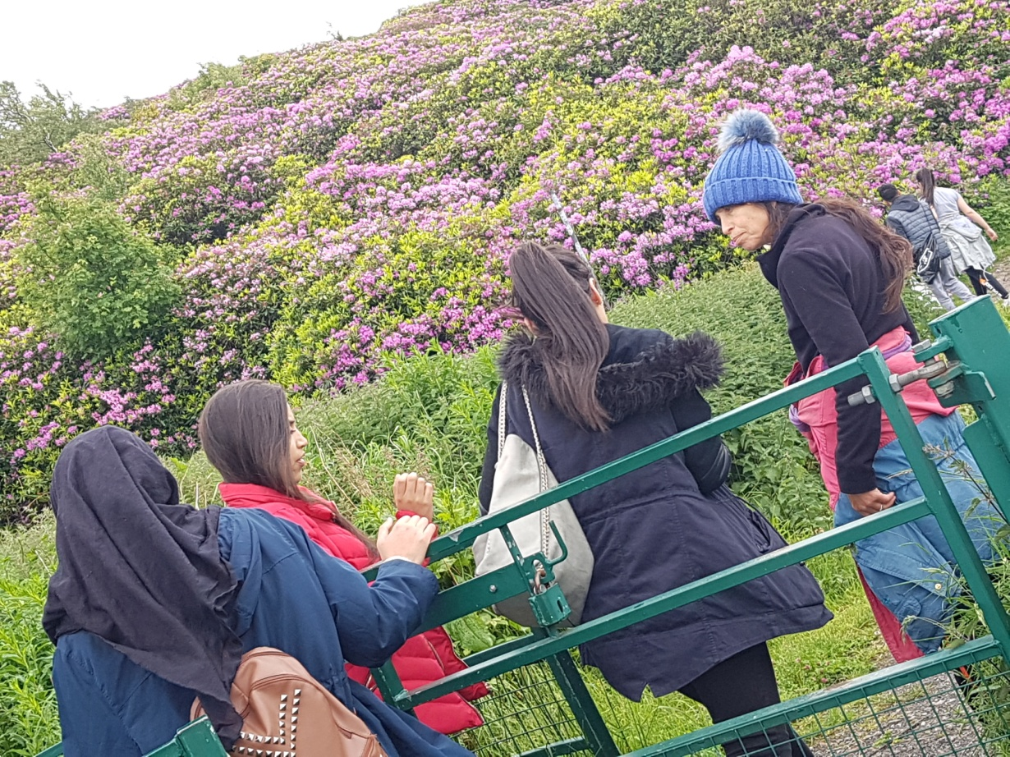
Health by stealth
‘I found the walk we went on in to Beacon Hill very peaceful and refreshing as it was a good way of relieving stress and learning new things about my town that I did not know!
Communicating with Dipika, Katie and Brian was very interesting as they were open with listening to our views about Calderdale’s Health and why many teenagers our age would not participate in the exercise. We did explain the different reasons and what facilities or opportunities that there may not be in place therefore many people are quite unhealthy.
I look forward to going on more walks and getting involved in more projects with the team as I feel like we could make a change as our voices are being heard and changes can be made- SS

Slide 25
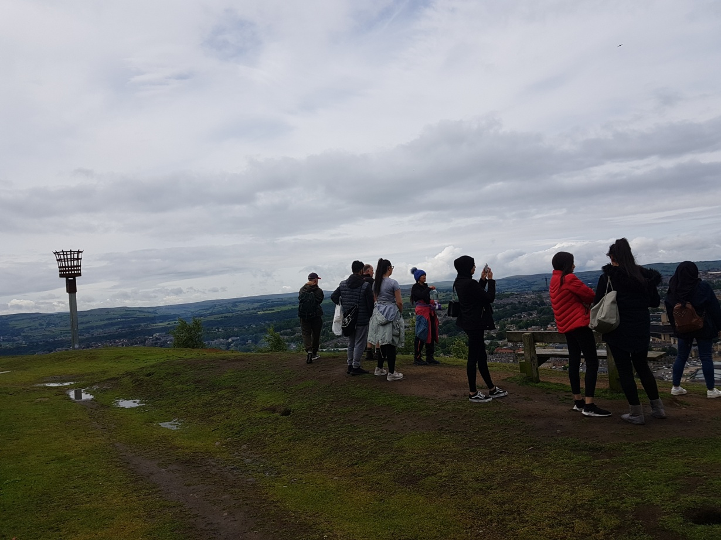
Happy, healthy & connected people /communities
‘ I really enjoyed being out with the group as it enabled me to get to meet new people that I would not have necessarily got to meet. The three leaders where very engaging and informative about the sights around Shibden park and the surrounding areas.
I feel if we could make this a regular thing and get more young people involved, it would be a beneficial thing for all involved; not only would it benefit people’s physical and mental health but also be a good way to bring communities together.
I look forward to hopefully being a part of more walks.
PM

Slide 26
Scaling up
Active Ambassadors – social movement to encourage others to take part in keeping active
Commitment to deliver Social action project/s working with 2 cohorts of young people – Conversations, social media campaign, events to promote intergenerational and cross sector movement 2019/21 (insight and outcome)
Regional sign up and roll out of social campaign to actively support this agenda and create positive social change

Slide 27
Challenges of scaling up
Capturing hearts and minds - people choosing to take responsibility for their own health & wellbeing
Embedding positive behaviour and culture change across communities & professionals
Resources to make this happen BUT not only monetary
Outcome is accessible and inclusive to all inc. Spaces and places for people in urban and rural environments

