Slide 1
Understanding the health and care system: how VCSE can engage
September 2019

Slide 2
Overview
This workshop is for VCSE organisations and will equip VCSE organisations with an;
Understanding of the Long Term Plan and how integrated care systems work
Awareness of how VCSE organisations are currently engaging with integrated care systems
Opportunity to shape NHS England and Improvement guidance on what good looks like

Slide 3
NHS Long Term Plan: Our Commitments
1
Do things differently, through a new service model
2
Take more action on prevention and health inequalities
3
Improve care quality and outcomes for major conditions
4
Ensure that NHS staff get the backing that they need
5
Make better use of data and digital technology
6
Ensure we get the most out of taxpayers’ investment in the NHS
Invest an extra £20.5bn by 2023

Slide 4
Developing a new service model for the 21st century
Key changes
  Boosting ‘out-of-hospital’ care bringing, primary and community health services together
  Redesigning emergency hospital services
  More personalised care
  Making better use of digital approaches to care
  Focusing on population health management
1,000 social prescribing link workers recruited by end of 2020/2021
1,200 Primary Care Networks created by July 2019
Backed by additional investment of at least £4.5 billion in primary and community care by 2023/24

Slide 5
Working with the Voluntary Community and Social Enterprise (VCSE) Sector
NHSE/I Voluntary Partnerships Team;
‘Working to develop and maximise the contribution that the voluntary sector and volunteering can have on services, communities and individuals and system transformation’.
NHS Long Term Plan Commitments | We will achieve this by
To continue to commission, partner with and champion VCSE | Facilitating the spread and scale of innovative practice and effective partnership working
Every ICS to have a partnership board, drawn from ……….the voluntary and community sector and other partners | Embedding the voice of the VCSE sector across the NHS
To double the number of volunteers in the NHS in three years | Reducing the barriers to volunteering and partnership working
Notes:
Member Sara’s arm of team:

Slide 6
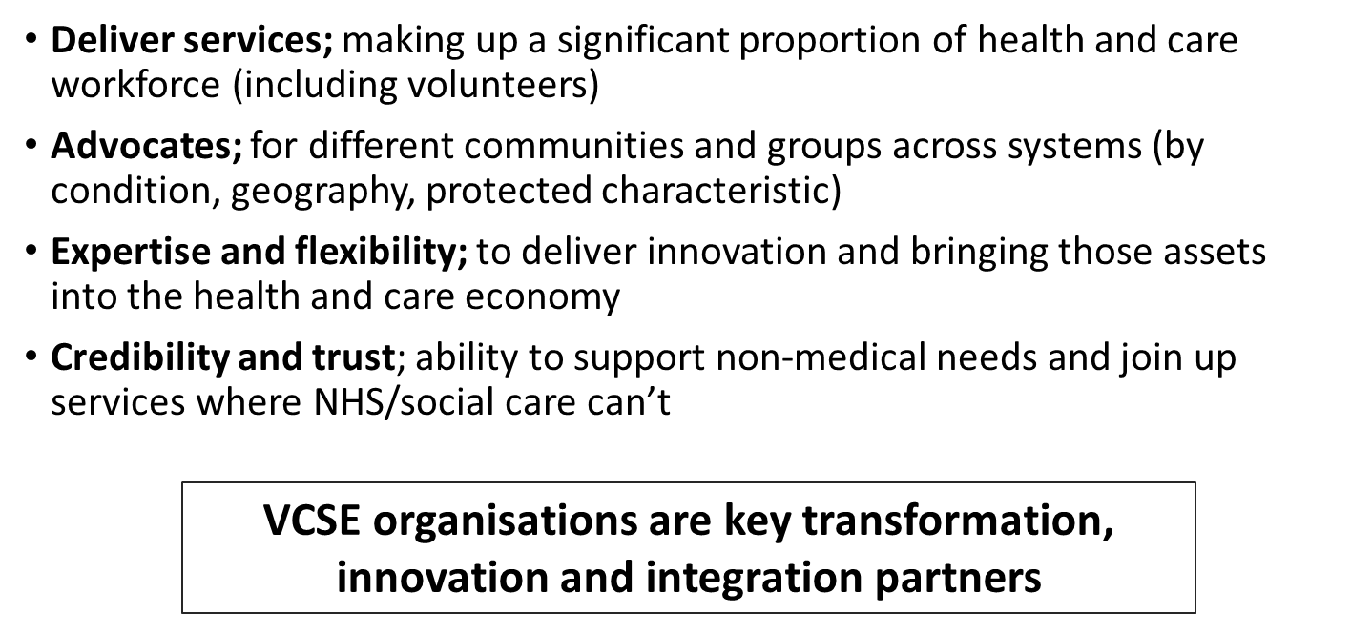
Why partner with the VCSE?

Slide 7

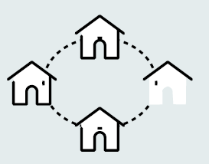
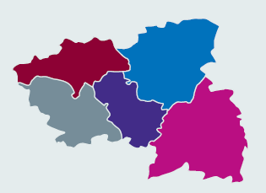

Level
Population size
Purpose
c. 30,000 to 50,000 people
Integrated multi-disciplinary teams
Strengthen primary care through primary care networks
Proactive role in population health and prevention
Services drawing on resource across, VCSE and , independent sectors plus other public services e.g. housing teams
Neighbourhood
Place
c.250,000 to 500,000 people
Typically borough/council level
Integrate primary, community, local govt & hospital services
Develop new provider models for ‘anticipatory’ care
Typically, over 80% of VCSE funding and delivery is at place level
System strategy and planning
Develop governance and accountability arrangements across system
Implement strategic change
Manage performance and collective financial resources
Identify and share best practice across the system, to reduce unwarranted variations in care and outcomes
System
c. 1 million to 2 million people

Slide 8
Spotlight on Lancashire and South Cumbria
Neil Greaves - Head of Communications and Engagement, Healthier Lancashire and South Cumbria

Slide 9
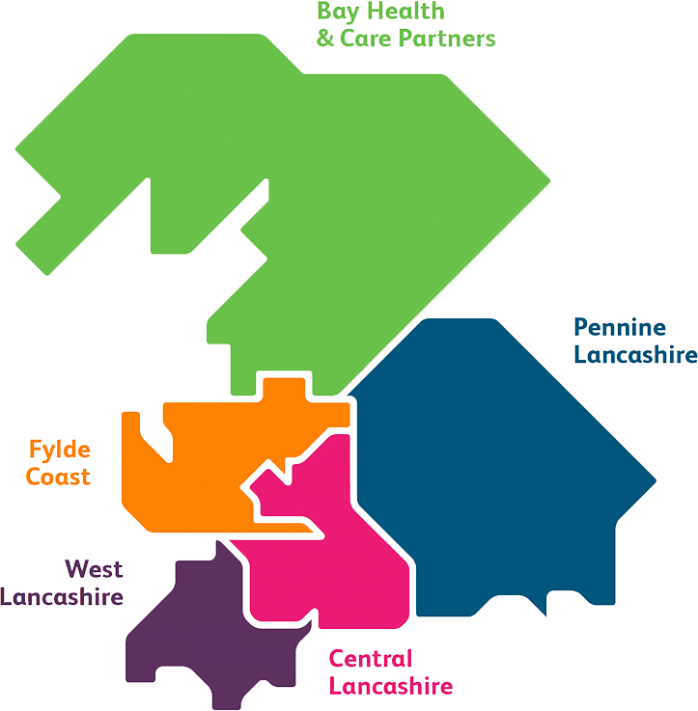

Covers 1.7 million people
5 Integrated Care Partnerships
Priorities
Out of Hospital
Acute and specialised services
Mental Health
Prevention and Population health
Workforce

Slide 10
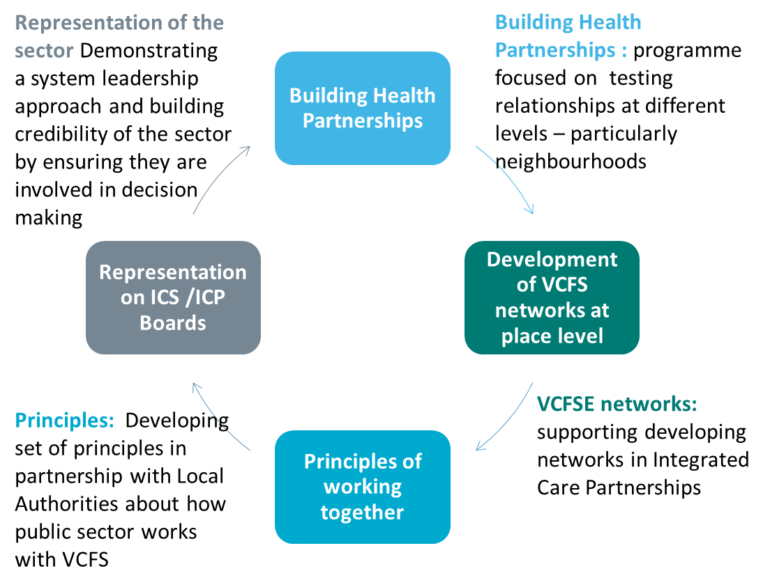

Slide 11
Representation of the sector Demonstrating a system leadership approach and building credibility of the sector by ensuring they are involved in decision making
Building Health Partnerships : programme focused on testing relationships at different levels – particularly neighbourhoods
Building Health Partnerships
Development of VCFS networks at place level
Principles of working together
Representation on ICS /ICP Boards
L&SC
VCFS Leadership Alliance
VCFSE networks: supporting developing networks in Integrated Care Partnerships
Principles: Developing set of principles in partnership with Local Authorities about how public sector works with VCFS

Slide 12

How can the Voluntary Sector Work with Primary Care Networks
Pip Goff
pip.goff@forumcentral.org.uk
Third Sector and Community
Local Care Partnerships

Slide 13
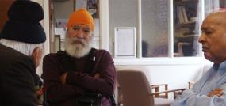

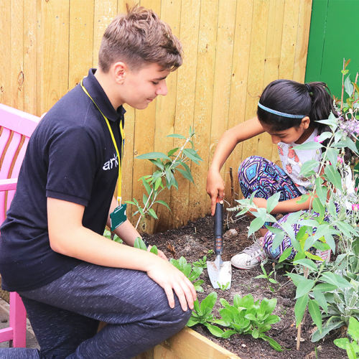

Third Sector:
Strength and agility
People and Communities
Local intel & contacts

Slide 14
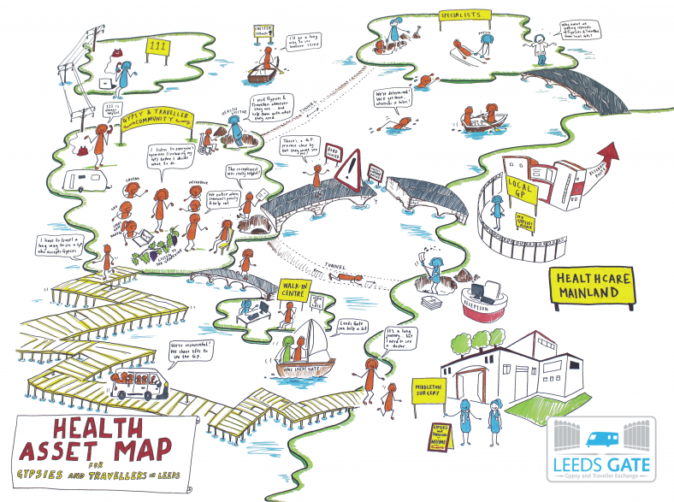
Notes:
Recognition of Third Sector contribution

Slide 15
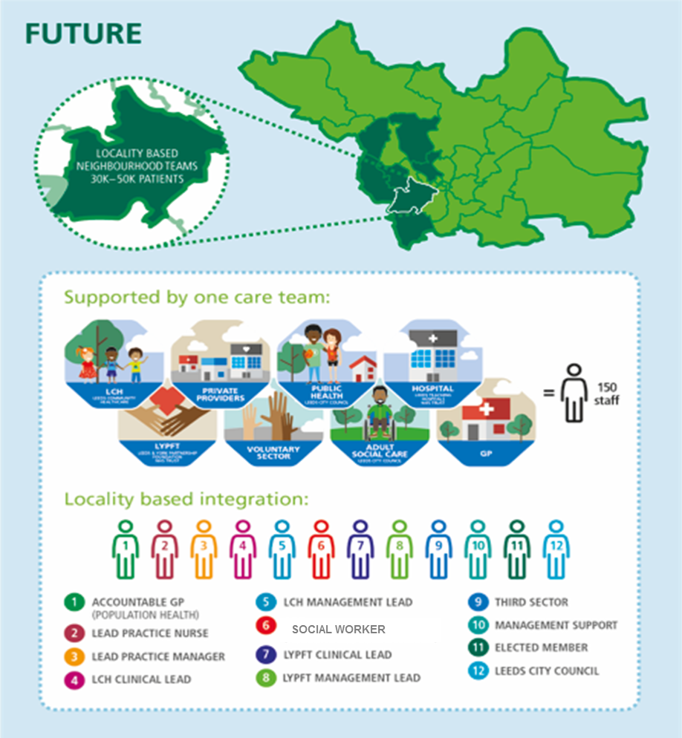
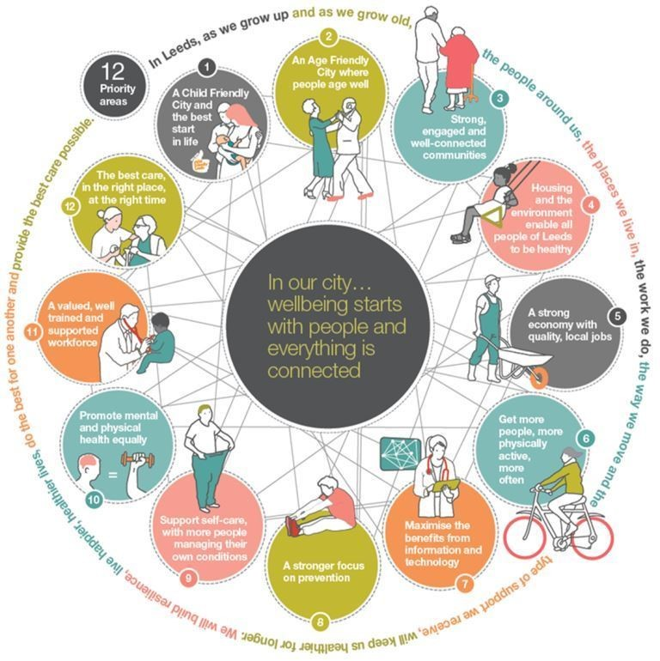
Leeds Approach: Local Care Partnerships
  Leadership
  Citizen involvement
  Social movement
  (see link for more)

Slide 16
300 diverse third sector organisation members supporting health and wellbeing
History of strategic partnership; mechanisms to provide information for and about the sector; share good practice; partnership opportunities

Slide 17

Third Sector delivery in Primary Care examples:
Personalised Care Hospital to Home; People in Action ; HEA; Co Production
Wider Determinants of Health – Leeds Poverty Truth Challenge
Population Health Management: SWIFT workers
Addressing health inequalities; Catch; Time to Shine; Tackling Loneliness; Solace; Basis
Prevention – Peer support; Neighbourhood Networks; Age Friendly Communities;
Outcomes Health Grants

Slide 18
Positives for Third Sector:
Engagement for diversity of organisations – including hyperlocal, citywide and regional
Allows differences in capacity and resources
Each at different stages of development
Very relational = third sector strength
Supports creative and responsive approaches
Social Value and Community Assets
Collaboration/sharing (less competition)
Potential for future funding

Slide 19
Role so far in the world of Primary Care
Neighbourhood level
Getting the word out and linking language and terminology
ensuring right people at tables
Bringing Third Sector/Social model perspective
Linking in existing activity & expertise eg. Employment
Population Health Management
Enabling Leeds Chat and Better Conversations
Social Prescribing eg recruitment support to PCN
Notes:
Challenges
Quality assurance / credibility
How to be integrated
Who is best placed
Where we want to end up?
Exploring system approach, message and

Slide 20
Role so far in the world of Primary Care
Place level
Strategic input to developing Social Prescribing
Convening Longer term conversation about integration and funding to ensure sustainability
Profiling the sector with GO Confederation, Target and events
System level
Representation and engagement: Harnessing Power of Communities; Personalised Care, Population health,
Integrated Care Partnership investment target at Harnessing Power of Communities
Notes:
Challenges
Quality assurance / credibility
How to be integrated
Who is best placed
Where we want to end up?
Exploring system approach, message and

Slide 21
EXAMPLES
OUTPUTS
Reach
OUTCOMES
IMPACT
e.g. Leeds Forum Central
e.g. Development of a Third Sector Health and Care Forum
The third sector is better connected and influential in the health and care system
e.g. *VCS Strategic Leaders Group, Harrogate – Mark Hopley
e.g. whole place or neighbourhood level
e.g. capacity and support for third sector representatives to attend strategic/ planning meetings
e.g. Harnessing Power of Communities Third Sector Health Grants
OR Bradford ABCD Microgrants
e.g. all Community Wellbeing organisations
OR
e.g. organisations serving a priority community
Investment in community organisations to innovate on delivering health and care outcomes
e.g. innovation grants
A sustainable third sector contributing to person-centred wellbeing across the health and care system
e.g. funds to scale up
e.g. Bradford Befriending Network
e.g. support to evaluate and calculate impact
e.g. West Yorkshire Finding Independence
e.g co-production, asset-based working
e.g. ABCD
e.g personalised approaches
e.g. a specific pathway of health and care
OR
e.g. a specific priority area
A system-wide culture shift to working in ways championed by the third sector
e.g. Livewell Wakefield
e.g. data-led decision making
e.G Vital Signs
e.g. System Leadership Sessions
e.g. Systems Leadership OD for third sector workforce
e.g. third sector mental health support workforce OR third sector social prescribing staff
Third sector workforce development to maximise systems working
e.g. State of the Sector Kirklees
e.g. Analysis of Third Sector workforce in place
e.g. Mental Health First Aid (youth and adult) Suicide Alertness
e.g. dedicated Third Sector capacity on one aspect of transformation
e.g. third sector leadership
OR
e.g. third sector frontline practitioners
Third sector capacity is increased to work in systems transformation
e.g. *Third Sector PCN development post Leeds – Pip Goff
e.g. secondment for third sector staff into systems transformation teams

Slide 22

3rd Sector feedback on
Primary Care Engagement
“Leeds has a good infrastructure”
“Positive recognition of complexity and richness of assets across the region”
“smaller local orgs can connect and have voice”
“A massive opportunity to be at the heart of improving health inequalities”
“We can use our good practice to inspire work in others areas across the region”
“Advantages of localities engaging with diversity of organisations”
“really good to heat how much the third sector is valued by GPs”
“A collective approach to common issues/ barriers”
“Drivers for change – coming from conversations”
“Real asset having Pip in post as dedicated Third sector champion”
“Allowing for different ways of engaging”
“shifting closer to communities and the CCG and Leeds City Council are both committing to this”
“It might take time as the early stages will need to focus on relationship building “
“our time and effort that we’ve invested in existing relationships and local working groups has lead somewhere”
“We need to think bigger than protecting our own organisations and think of what is best for citizens”
“Potential to bring different conversations together across the region”
“The use of existing networks and routes of engagement is encouraging”
“The LCP development team can help to drive how we link into city wide work and get people round the table”
“We feel relieved to hear about
the vision of the LCPs”

Slide 23
How to guide…
  Guidance for STP/ICSs on engaging and working in partnership with the VCSE sector at
    system level
    place and
    neighbourhood level
  Co designed and co-developed with VCSE partners at workshops and webinars
  Informed by work of Voluntary Partnerships Team

Slide 24
What good looks like at neighbourhood level
Features of VCSE partnerships at this level
VCSE included as partner on multi-disciplinary teams along with health, social care, supporting high-risk individuals and high-intensity service users
Connectors to other levels
Key community anchor organisations (e.g. community centres, community /neighbourhood associations) are supported
Grant funding is available locally to nurture and develop existing and new community groups, building on the skills and interests of citizens
Sustaining partnerships at this level
Social prescribing link workers in primary care networks are integrated into place-level social prescribing and VCSE plans
Information governance agreements in place with VCSE
PCNs map VCSE groups in their area and connect them with social prescribing activity
PCN work through VCSE partners in their area to engage with groups with poorest health outcomes
Neighbourhood-level community groups are connected to support at place level with funding, capacity-building
Capacity-building support is available for local community groups (e.g. on safeguarding, IG, food handling)
Social prescribing link workers connect people, their families and carers with relevant community groups
Population health management, local VCSE is mobilised to tackle local health challenges along with statutory partners (e.g. falls; isolation; respiratory health; smoking)

Slide 25
What good looks like at place level
Features of VCSE partnerships at this level
VCSE is represented in governance at place level (ICP/ICO/LCO)
Connectors to other levels
There is a grants programme for the VCSE supporting place-level priorities)
Partners protect and grow local VCSE infrastructure organisations (e.g. CVS)
Sustaining partnerships at this level
The local infrastructure organisation is a strategic partner for wider involvement of VCSE at place level
There is a clear local plan for social prescribing, developed with input from VCSE sector leaders, local CVS, local authority and health commissioners, PCNs, referral agencies and Health & Wellbeing Board
VCSE may be represented on Health & Wellbeing Board
VCSE representatives in place-level governance are part of a system-level VCSE alliance or leadership group
VCSE is involved in place-level workstreams, including leading some workstreams (e.g. redesigning models of care)
Outcomes and assurance frameworks agreed between VCSE & statutory partners (e.g. to assess impact of social prescribing)
VCSE is included in place-based leadership training for health and care partnership
There is training and support for local agencies to understand link worker roles

Slide 26
Table discussions
VCSE partnerships at system and place level
  (what would/could work, any challenges, how could these be overcome)
2. VCSE partnerships at neighbourhood level
(what would/could work, any challenges, how could these be overcome)
3 Connections and communication
(how do we connect VCSE partnerships and ensure that communication flows between all levels?)

Slide 27
Questions

