Slide 1
Transforming Healthcare
Together Conference

Slide 2
Welcome
Ben Cairns, Institute for Voluntary Action Research
Neil Churchill, NHS England
Jo Pritchard, Social Enterprise UK

Slide 3
Neil Churchill OBE Director for Experience, Participation and Equalities
Transforming Healthcare Together
26th September 2019

Slide 4
Recognising the VCSE as key transformation partner
NHS Long Term Plan Commitments
To continue to commission, partner with and champion VCSE
Every ICS to have a partnership board, drawn from ……….the voluntary and community sector and other partners
To double the number of volunteers in the NHS in three years

Slide 5
How we are supporting VCSE activity
‘Working to develop and maximise the contribution that the voluntary sector and volunteering can have on services, communities and individuals and system transformation’
Working with 20 VCSE Health and Wellbeing Alliance members
Working with 18 systems through Building Health Partnerships (jointly funded by National Lottery Big Community Fund)
Working with 9 systems with STP/ICS VCSE Leadership Accelerator programme and extending to another 12 systems – developing VCSE Alliances or groups at system and place level.
Support for VCSE engagement to 6-8 systems working in Primary Care Networks on Population Health Management
Alliance support to 5 systems
Transforming Healthcare Together – coaching, mentoring, workshops
STP/ICS Volunteering programme – open to all systems
Reducing barriers for VCSE partnership working

Slide 6
“Our partnership includes the voluntary sector because they are fundamental to our future success. The sector is embedded in communities and has the ability to bring insight, connection, capacity and innovation to what we do. This is essential in an era when we are joining up care to better meet the mental, physical and social needs of people”.
NHS colleague, West Yorkshire and Harrogate ICS

Slide 7
North Cumbria Stroke Prevention
215 people tested
43 referrals
200 people received advice
Bristol North East Somerset and Gloucestershire
Alliance formed
Funding for smaller VCSE organisations
2 yr action plan to support frailty
Staffordshire
End of Life Alliance supporting better care planning
Population Health Management
Supporting VCSE in design and delivery in primary care networks in 6-8 ICS
Notes:
Building Health Partnerships Programme focuses on VCSE in a service design and delivery role.
North Cumbria – Prevention of Stroke
80% of strokes are avoidable and VCSE organisations in Copeland worked on a public health campaign and carried out health MOTs at community events.
215 people were tested, 43 referrals were made to GPs or Pharmacists and 200 people received advice and information on stroke prevention.
In Wakefield - Preventing sight loss.
50% of sight loss is preventable, VCSE organisations and community groups delivered awareness raising sessions using Eyes Right Toolkit. The toolkit is used by Carers Wakefield which provides this free eye screening for some of the 36,000 carers in the area routinely as part of its support work. This initiative is offering real benefits for local carers who often forget about their own health because they are too busy thinking about someone else’s.
STP/ICS Accelerator Programme focuses on the creation of VCSE alliances/partnerships
Staffordshire
Creation of an End of Life Care Alliance bringing 17 organisations VCSE organisations together. Other activity included a Community Development in End of Life Care Conference, workshops for members and training on Asset Based Community Development
Bristol, North East Somerset and Gloucestershire
An alliance has been developed and funding was made available to ensure smaller VCSE organisations could participate. Impacts have included the creation of a VCSE involvement checklist and development of a 2-year action plan and supporting activity in the frailty workstream

Slide 8
Learning about each other – how are we collaborating?
Charlotte Pace, Institute for Voluntary Action Research
Helen Garforth, Institute for Voluntary Action Research

Slide 9
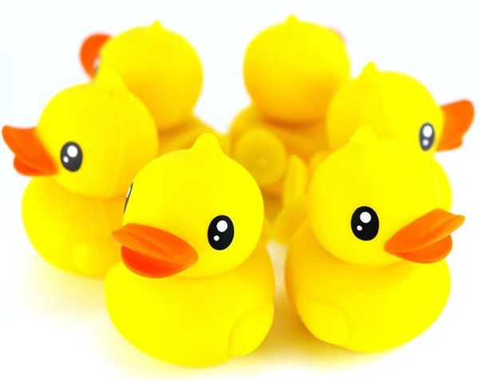

Slide 10
“What big challenge or question do you bring to this gathering?”
“What do you hope to get from AND give to, this group here today?”

Slide 11
Everyone at once with the same amount of time
Everyone has an equal opportunity to contribute

Slide 12
“Talk to me about”

Slide 13
Refreshment break

Slide 14
Workshops 12:00 – 13:00
Workshop | Room
Getting started with collaboration
Understanding health systems and structures
Creating a healthy, including and compassionate culture in the NHS workforce
Leading and creating VCSE partnerships and alliances

Slide 15
Lunch

Slide 16
Workshops 13:45 – 14:45
Workshop | Room
Getting started with collaboration
Working together to improve health and care outcomes: preventative action and end of life care
How to build relationships that last
Leading and creating VCSE partnerships and alliances

Slide 17
Refreshment break

Slide 18
Panel discussion
Chair: Ben Cairns, Institute for Voluntary Action Research
Neil Churchill, NHS England
Julie Clayton and Kevin Walsh, North Cumbria
Dipika Kaushal, West Yorkshire and Harrogate
Neil Greaves and Joe Hannett, Lancashire and South Cumbria

Slide 19
Thank you for coming
Access further support:
www.ivar.org.uk/transforming-together

