Slide 1



Nottingham and Nottinghamshire
Partnership Session no.1
Help us tackle Delayed Transfers of Care
Friday 23rd November
Jointly funded by
NHS England

Slide 2
The national Building Health Partnerships (BHP) programme is working with the Nottingham and Nottinghamshire Health and Care System and the Voluntary and Community Sectors to establish a clearer picture of what is happening now, and what could be implemented in the future to improve the process of patients being discharged from hospital.
UNDERSTANDING BUILDING HEALTH PARTNERSHIPS (BHP)
The Building Health Partnerships programme aims to:
create a better understanding of the circumstances resulting in delays;
improve our understanding of all the services and types of care that are available through the voluntary and community sectors, how to access them, and identify where the gaps are (so what is not available but could be);
look at how we could jointly develop and implement what is required (e.g. appropriate packages to support patients going home);
build capacity to respond to demand.

Slide 3
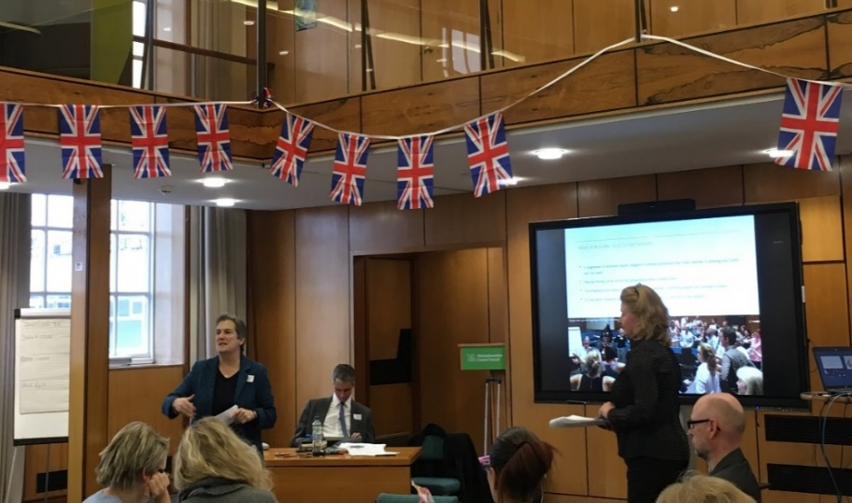
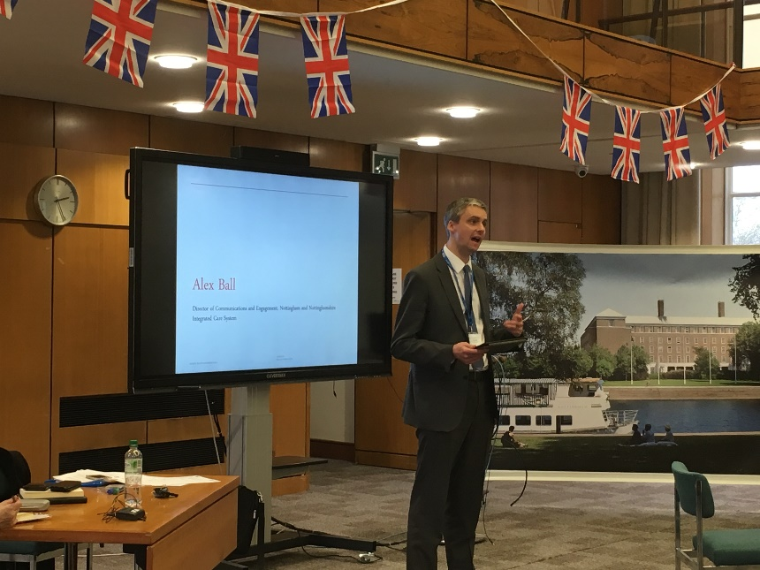
LOCAL CONTEXT
David Pearson: Nottingham ICS Lead
A focus on Delay Transfer of Care (DToC) to be more cost-effective, better for the population and working together to ensure a solution (with technology)
‘Every extra day an older person is in a hospital bed results to a year less of physical mobility’
Kay Parker: Integrated discharge Lead
Work with services to help patients get the best environment to recover, hence the focus is on home-first along with safe and timely discharge. Helping people find the correct pathway (described three pathways)
Ian Haines: Strategic Development Manager
DToC can be improved by enabling patients to go onto the right pathway. Making hospitals aware about the services available for the patients, post discharge, will enable discharges to happen faster
Alex Ball: Director of communication, Nottingham ICS
DToC has an impact on the cost as well as the recovery time and hence, we need to solve this concern with tangible solutions through conversations and making stronger connections
‘Aim to look outwards for answers and then inwards’

Slide 4
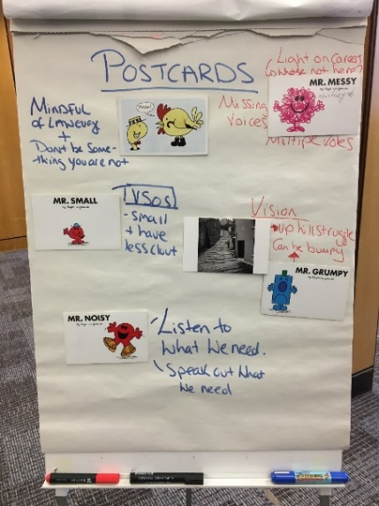
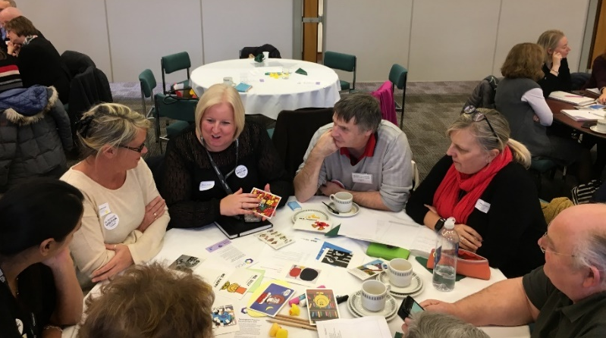
WHAT DOES PARTNERSHIP LOOK LIKE IN NOTTINGHAM AND NOTTINGHAMSHIRE?
Need to be mindful of language used during partnership working, do not use jargon, language must be accessible
Do not try to be something you are not
Voluntary sector organisations are smaller, have fewer resources and capacity, and can have less clout
Need a clear focus and vision to work towards
Partnership work can be bumpy and an uphill struggle
There are missing voices, who is not here that should be heard, are all relevant partners being represented i.e. carers and patients
Individuals have multiple roles
Partnership building is about recognising the differences and working past it for a common goal
BHP must be a place where the community is able to speak out about what they need and a place to listen as well
Partnerships must include small and medium sized VCSEs

Slide 5

THE CORE GROUP
Alex Ball - Director of Communications and Engagement, Nottingham and Nottinghamshire Integrated Care System
Jules Sebelin & Becky Cameron – Head of Business Development/Deputy CEO & Head of Engagement, Nottingham Community & Voluntary Service
Ian Haines - Strategic Development Manager, Adult Social Care and Public Health Transformation Team
Louise Dabell - Project Manager, Home First / Discharge to Assess Workstream - Greater Nottingham
Lewis Etoria – Head of Communications & Engagement, Nottingham and Nottinghamshire Integrated Care system
Jane Laughton – Interim CEO, Healthwatch Nottingham & Nottinghamshire
Tinu Akinyosoye - Rodney – Programme Manager, NHS Midlands and East Strategic Projects team

Slide 6
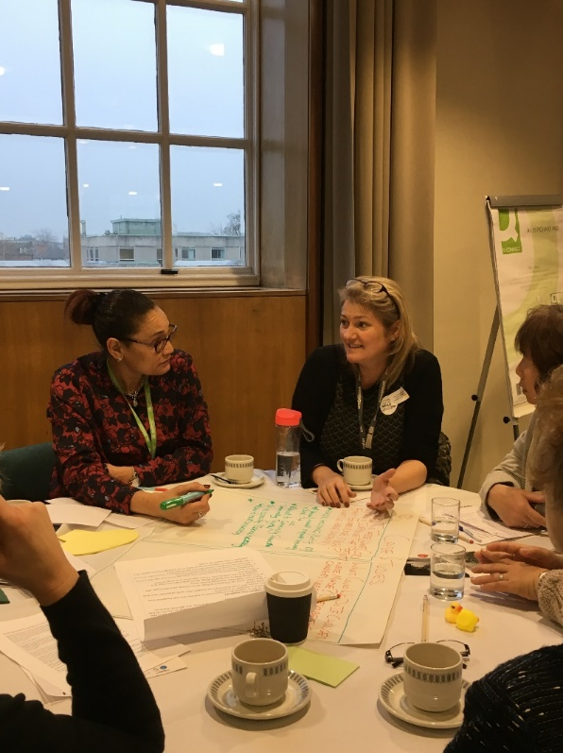
CASE STUDIES
Key themes highlighted from three case studies looking at the problem of DToC from the community- side:
What could we do to improve the patient/ family experience now? | What could we do if changes were made?
Risk aversion | Develop community connectors
Understanding whose responsibility it is | Capacity building in the voluntary sector
Person-centred approach to community and listening to the patient | Embed a pathway of services
Understand what’s in the community and developing an asset-based approach | Technology
Notes:
2 –
3 – do m ore

Slide 7

Action plans

Slide 8
Idea under development
Long term funding for a consistent navigator and facilitator/ housing offer for discharge support
What do we need to make it happen?
Joined up thinking and funding to enable sustainable support offer
Looking at quality of life, impact as well as savings made impact
Skills and capacity
Several examples of well-regarded projects with short term funding challenges
Very next steps
Draw up current picture of discharge support services, what they cover and how long they are funded, for e.g. benefits, groups
Notes:
2 –
3 – do m ore

Slide 9
Idea under development
Invite other representatives to encourage better understanding e.g. private care providers
Look into recruitment challenges: possible forums; staff groups; localities
What are the barriers/ solutions?
What do we need to make it happen?
Systems that speak to each other
The individual do their own case management: knowledge of health and wellbeing
Addressing the gap in resources and home assessment need to be more focused
Skills and capacity
Knowledge around DToC
Junior Doctors supported to allow discharge- if a medical professional is able to take responsibility in the community, patients should also be allowed – joint discharge
Very next steps
Look at the root cause
Communication around DToC
Communication with wider sector
Notes:
2 –
3 – do m ore

Slide 10
Idea under development
Embed community connectivity within hospital settings and primary care
Challenging risk adverse practice
What do we need to make it happen?
Continued/ increased funding for community voluntary sector communications and engagement
Improve shared working practices
Culture change
Skills and capacity
Online service directories
CVS’s
Community together surgeries
Very next steps
Invite other representatives to encourage better understanding e.g. private care providers
Look into recruitment challenges: possible forums; staff groups; localities
What are the barriers/ solutions?
Notes:
2 –
3 – do m ore

Slide 11
Idea under development
Move from two careers to one
By creating alternative solutions including, patient choice, assistance technology, risk assessment.
Risk taking, patient choice is going home for bed based care better.
What do we need to make it happen?
Equipment e.g. Hoist; Pressure care; Hospital bed; A.T.
- Link it to occupational therapy (greater use of OTs in training people around double up
- Greater awareness
- One ‘go to ‘ location for A.T
Community connectivity: do we need voluntary sector to provide input into the homes
Skills and capacity
Utilise carers/ patient voice about how to do better care at home
What is the role of the voluntary sector supporting this?
Understand what AT can offer?
Very next steps
Trial and evaluate
Notes:
2 –
3 – do m ore

Slide 12
Idea under development
Community connectivity, social prescribing scheme- public understanding and co-production
Support ‘video’ idea demonstrating system approach to person and community – centred approaches / experience of discharge/ different conversation
MECC: ‘make every conversation count’
What do we need to make it happen?
Raise at next core group
Small group to plan and make happen- ICS to lead
Voluntary sector mapping and link workers
Share details next core group
Small group to plan and make happen- ICS to lead
Voluntary sector mapping and link workers
Share details
Skills and capacity
Integrate discharge team/ home first project (for data to inform)
Capacity in community- both funded and engage citizens developed by local people
Person and community: ICS community centred approaches programme
Health watch discharge materials
Theatre and videos are a powerful method
Outside confetti- Nottingham college
Very next steps
Next core group meeting
Link in with community centred approaches co-production forum (Greater Notts)
Identify/ invite citizen representation to core group. Patient groups etc. focus dependent
Link into ICS communications group
Notes:
2 –
3 – do m ore

Slide 13
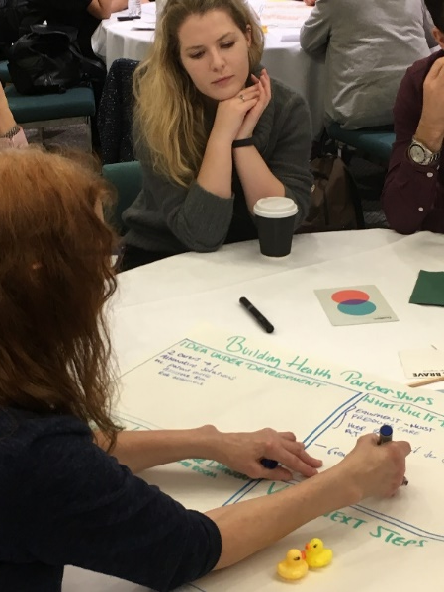
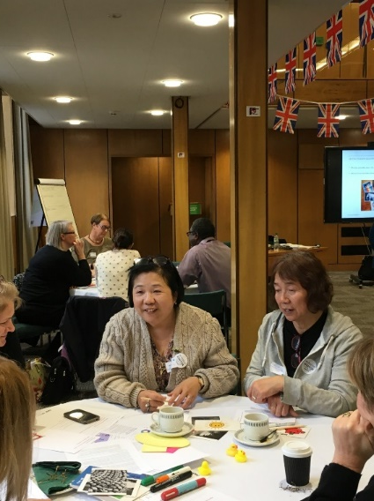
LINKING TO EXISTING RESOURCES
Understand existing reviews on DToC pathways across the whole system
Understanding organisational memory
Link to the clinical strategy

Slide 14
Institute for Voluntary
Action Research
020 7921 2940
@IVAR_UK
ivar.org.uk
Social Enterprise UK
0203 589 4950
@SocialEnt_UK
socialenterprise.org.uk
To read more about Building Health Partnerships, please visit
ivar.org.uk/our-research/building-health-partnerships

