Slide 1
Getting started with Collaboration
Where to start, when you don’t know what’s out there
West Yorkshire and Harrogate (WYH) accelerator site – investment in the VCSE sector:
The learning from the accelerator programme in WYH around investing in and collaborating with VCSE organisations
What we set out to do – and why, what difference or change we were hoping to make to local collaboration
What we did, and what we learnt (what to do/what not to do!) and some top tips/ideas to share for going about similar exercises
How we are embedding the outputs/outcomes

Slide 2
The challenge….
How do you ensure that the VCS is fully integrated into a large, complex Integrated Care System?
The ICS focuses on 6 places plus system with an emphasis on subsidiarity, only doing things at a system level where they meet the triple aim.

Slide 3
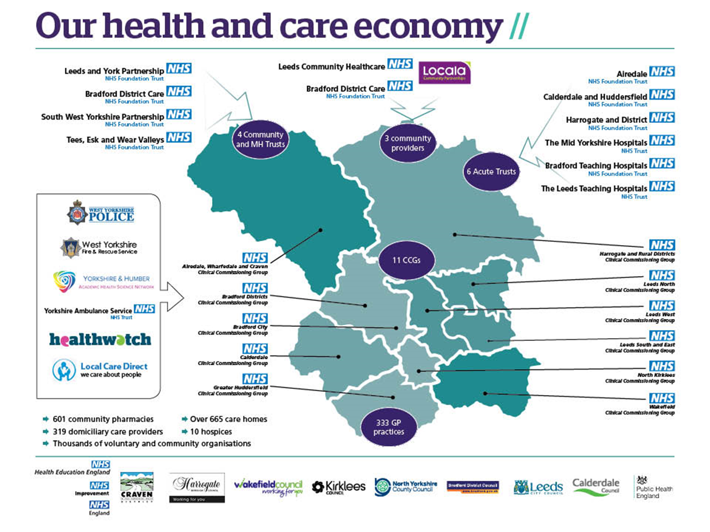
West Yorkshire and Harrogate Health and Care Partnership

Slide 4
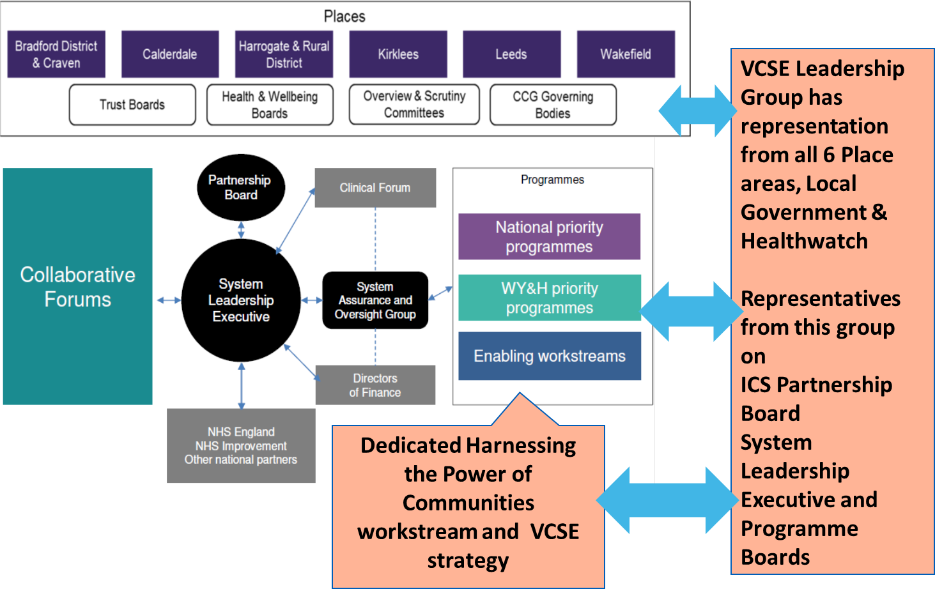
How the system works in practice

Slide 5
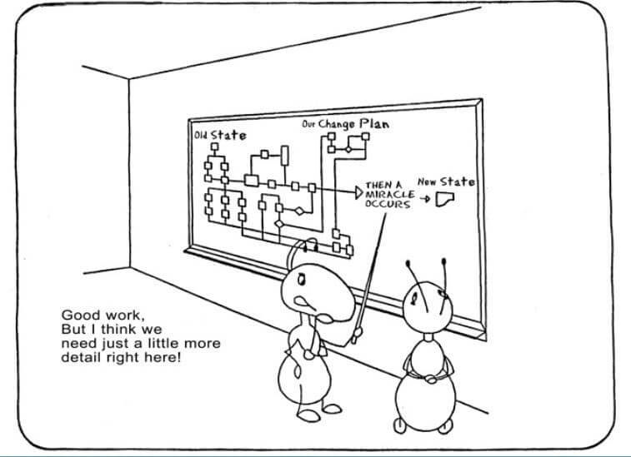
And then….

Slide 6
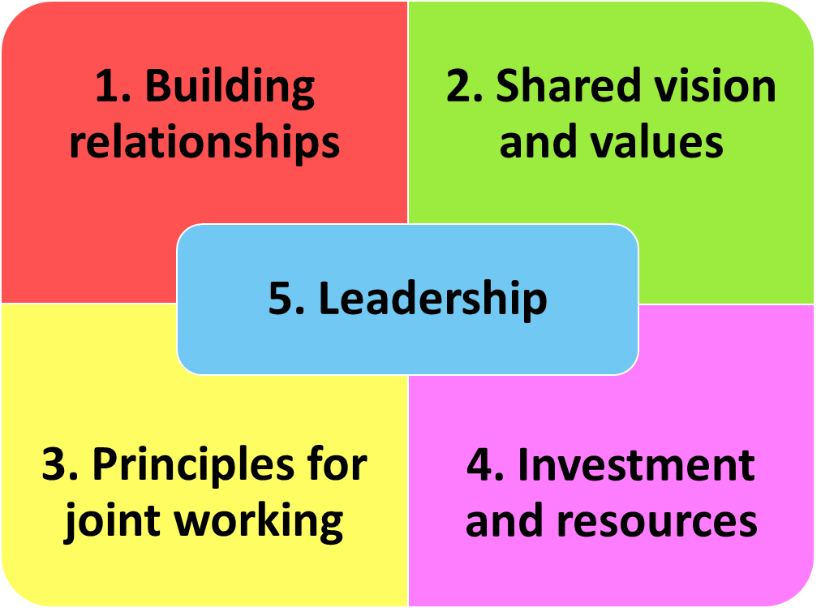
Key findings

Slide 7
Wins
Transformation funding 18/19: Focus on loneliness and front line delivery
Transformation funding 19/20: Focus on system integration and adding value
Workforce Funding 19/20: 3 projects that support communities and the system
System Transformation Funding: Resource to support the workstream
And seats all over the shop….

Slide 8
Over to you….
What challenge do you think working collaboratively across sectors could make a difference to? What might get in the way?
What have you heard today that you will implement or use to improve collaborative working?
Writing out on a postcard, ‘What ideas for change will you take back to your organisation/system?’

Slide 9


Slide 10


Tackling Delayed Transfers of Care Nottingham & Nottinghamshire
Jointly funded by
NHS England

Slide 11
Getting started with Collaboration
Where to start, when you don’t know what’s out there
The learning from the accelerator programme in WYH around investing in and collaborating with VCSE organisations
What we set out to do – and why, what difference or change we were hoping to make to local collaboration
What we did, and what we learnt (what to do/what not to do!) and some top tips/ideas to share for going about similar exercises
How we are embedding the outputs/outcomes

Slide 12
The challenge….
What it will take to reduce the number of patients who end up staying in hospital when other options (in particular going home) would be far better for their health and well-being.
The focus of this action research project is the Greater Nottingham area, with a specific focus on Nottingham University Hospitals (NUH).

Slide 13
LOCAL STUDY
A local study reviewed 22 real cases from different hospitals in Notts
Range of practitioners from health and social care looked at the cases and what had happened
In 12 cases a the person had left hospital on the most suitable, independent pathway but for 10 of those cases - an alternative, more independent pathway was identified. Issues arising from the study:
  In 41% of the 10 cases a person who had to go into residential care could have stayed at home with the right support
  Social care staff in hospitals very busy and are under pressure to discharge as quickly as possible
  Not all staff in hospitals always aware of what was available in the community and voluntary sector
  More work needed to be undertaken with health colleagues to ensure positive risk taking and ensure a range of range of options are considered on discharge
Notes:
Most people leaving hospital want to go home and this is our primary aim

Slide 14
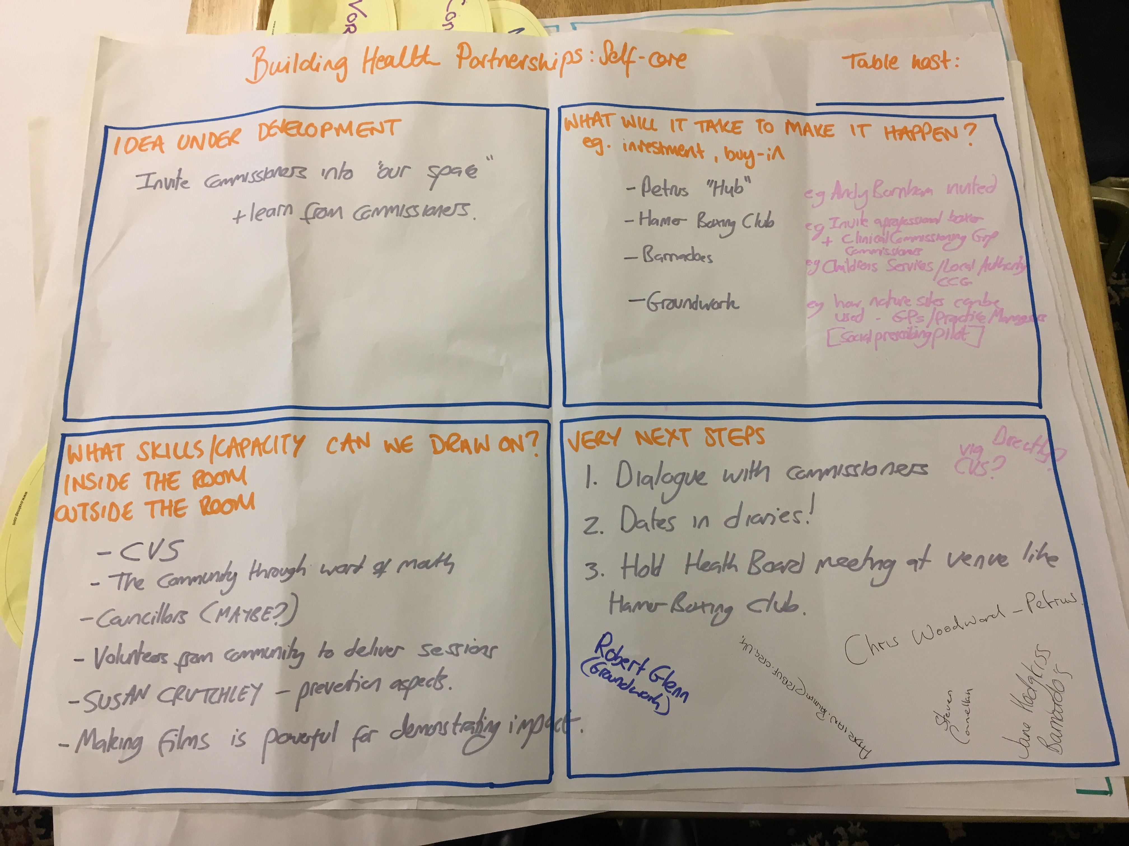
Prioritising the focus
.

Slide 15

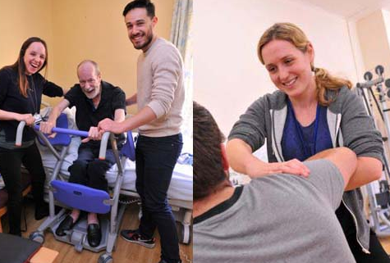

NUH, Social workers, ward staff, therapists, Age UK, Mental Health, Care workers, Nursing staff, STOC teams, DISCOs
Referral to 1 single point
An agnostic team accountable for the discharge of Greater Nottingham citizens at pace
County Hub
City Hub
Integrated Discharge Function
Discharge to Assess | Discharge to Assess
Pathway 1
Pathway 2
Pathway 3
Patient needs can be safely met at home
Patient requires further reablement and assessment in community facility
Patient has complex ongoing care needs requiring further assessment
The individual’s needs can be safely met at home with further reablement to regain independence
The individual is not yet able to return home and requires further reablement and assessment in a bed based community service before they return to their usual place of residence
The individual is not yet able to return home and there are doubts about their ability to regain independence and return to their usual place of residence

Slide 16
What happened….
Scoping the research
Briefing and conducting interviews or conversations
Analysis of conversations
Action plan based on recommendations
And so far:
  Excellence in Discharge Study day
  Winter Pressure Marketplace event
  Hospital connections

Slide 17
What we learnt….
Co-designing the approach makes for a better and more informed action research exercise - different angles with different expertise
The process is as important as the result (form follows function)
There are more voluntary organisations with the skills/ experience/ networks to jointly work with on delayed transfers of care than expected
Importance of knowing what is out there in the community and making the most of the existing assets/ knowledge (and not mapping)

Slide 18
Over to you….
What challenge do you think working collaboratively across sectors could make a difference to? What might get in the way?
What have you heard today that you will implement or use to improve collaborative working?
Writing out on a postcard, ‘What ideas for change will you take back to your organisation/system?’

