Slide 2
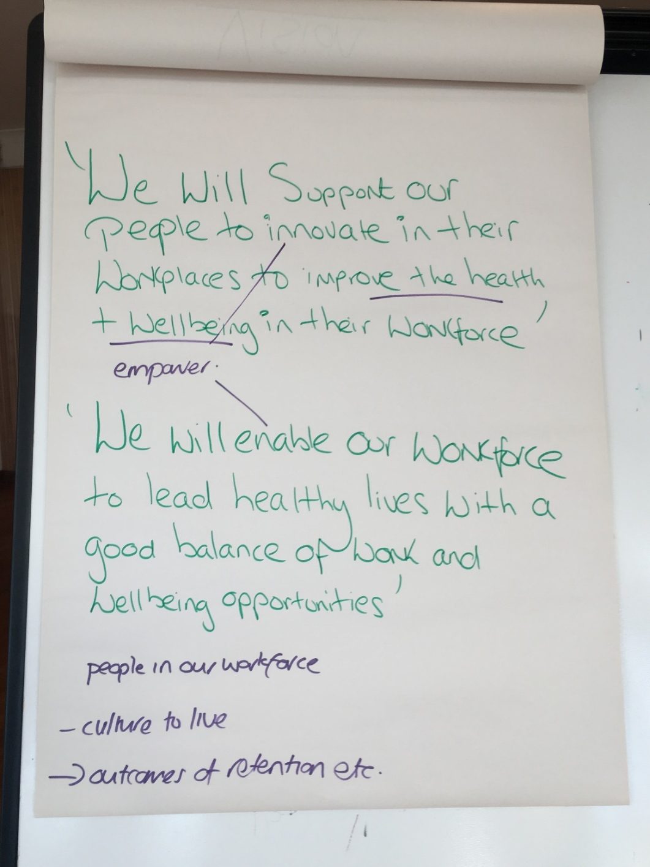
Explore how workplace wellbeing may vary depending on the sector
Individuals need to take responsibility for choices and self care
The language used needs to be inclusive and not suggesting being done to
Create a culture to encourage healthier behaviour
The system needs to acknowledge the work of the workforce initiative
Give the workforce ‘permission’ to pursue a healthier lifestyle
Outputs: increase productivity and feel excited about work

Slide 5
Drink water in the morning before your usual cup of coffee or tea.

Slide 6
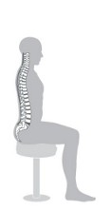
Sit up straight
and
walk tall.

Slide 7
Stand up for 15 minutes per hour of sitting.

Slide 8
Eat more healthy snacks – get your 5 a day.
5

Slide 9
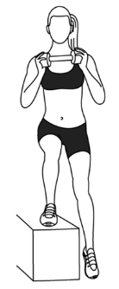
Try and get 30 minutes
of exercise each day.

